Slide 1

SweetWater Health
TM
BeatHealthy
TM
Chiropractic and HRV
November, 2012

Slide 2
Heart Rate Variability and Chiropractic
As a Chiropractor your goal is to manage and promote the performance of human potential and inspire patients toward systemic health
To do this effectively you need to comment on the state of a patient’s overall health, not just the state of their spine
  The state of the Autonomic Nervous System (ANS) can reveal the systemic health of your patients
    If the ANS is not working, the body does not work
    You can’t have good heart and organ function with poor ANS function
    While doctors are concerned with weight, blood pressure, liver enzymes, digestion and kidney function, they don’t look at the system (ANS) that controls these functions
Heart Rate Variability (HRV) is a non-invasive and inexpensive technique for measuring the state of the ANS
HRV is an invaluable metric for a wellness centered office
Notes:
Jo Beth Dow and I founded SWH in Feb, 2011
While we develop apps as part of our product, we are a software technology company
Our mission is to analyze the patterns of the heart beat, known as Heart Rate Variability, AND the patterns of Heart Rate Variability to detect onset of specific conditions
The app and mobile platform serves as a real time detection device and as a data collection platform that utilizes 3rd party sensors and heart rate monitors.
Our backend database is mined and advanced analytics are utilized to detect disease specific patterns in the data
A rich and graphical tool suite brings the data to life with application specific functionality and user interfaces

Slide 3
HRV in Practice
HRV analysis can help plan and track the course of treatment
  Low ANS activity indicates less adaptability and the need to proceed slowly in treatment
  ANS is a valuable indicator of improvement long before symptoms have resolved
  Detect ANS blocking or ANS dysregulation (switching) to enable healing
  Track recovery from treatments for proper scheduling
Eliminate trial and error that occurs when patient is not responding to treatment
Adjust patient’s ANS as well as their spine
  Research shows that Chiropractic adjustments improve HRV and balance the ANS
  Determine ANS damage, dysfunction or interference
  Taylor care plan to the individual system as well as spine
  Determine whether treatment is balancing ANS or masking symptoms
  Ascertain whether pain is chronic or psychological in nature or acute from the suspected cause
    Acute conditions will respond to adjustments and improve over time
Notes:
As chiropractors we understand that subluxations alter the tone of the ANS. Sympathetic tone can increase, PS, vagal tone will be altered under the strain of persistent stress and eventual subluxation. We also understand how to interact with the ANS with specific adjustments. We see this imbalance and change in patient’s vitality all the time. While we develop apps as part of our product, we are a software technology company
HRV testing in a chiropractic setting most commonly evaluates two things: ANS activity and sympathetic/parasympathetic balance. Let's investigate the ANS balance issue first. In general, the sympathetic nervous system (SNS) speeds up bodily processes and is responsible for the "fight or flight" response that most of us are familiar with.¹¹ The parasympathetic nervous system (PSNS) slows down most bodily process and is mostly responsible for producing states of rest, or the "rest and digest response."¹⁵ During the average waking day, these two systems should be fairly well balanced.^{8,9} However, if the balance shifts to being too SNS dominant, than we often will see signs and symptoms such as high blood pressure, muscle cramps, nervousness, indigestion, heart burn and insomnia. Factors that can shift the ANS into this state are: pain, mental/emotional stress, certain medications and trauma, to name a few.¹⁶ On the other hand, if the system shifts to being too PSNS dominant, then we will likely see conditions such as: acid reflux disease, fibromyalgia, chronic fatigue, and in severe cases, the inability to mount a healing response. In the average chiropractic office, knowing the resting balance of the ANS can be very useful in determining whether the patient is really in pain or is malingering, whether the pain is chronic/psychological in nature or acute from the suspected cause, and whether the treatment being given is actually improving the ANS balance or simply masking symptoms, the "chiropractic aspirin."The app and mobile platform serves as a real time detection device and as a data collection platform that utilizes 3rd party sensors and heart rate monitors.
Now that we have looked ANS balance, let's look at how ANS activity translates into real world practice. In HRV testing, ANS activity is commonly measured on a composite scale from 0 through 150. The scale is a composite of multiple studies that address the normal values for HRV in different age groups.¹⁷ HRV values tend to decrease with age. ANS activity is often used to assess the health of the nervous system. Low ANS activity relates to a less healthy nervous system and can be used a predictor for Type II diabetes, and heart disease.8 However, in a chiropractic practice, ANS activity is often used as a predictor of adaptability. In other words, it can tell the doctor how well is this patient going to respond to chiropractic care. For example, a low ANS activity tends to indicate less ability for the nervous system to adapt and can indicate the need to proceed slower in the beginning of care to prevent the patient from getting much worse before improvement occurs. It can also be a valuable indicator of improvement in the patient's condition long before the symptoms have resolved.
A rich and graphical tool suite brings the data to life with application specific functionality and user interfaces

Slide 4
Benefits
Non-invasiveness of the test. HRV testing does not require needles, blood draws and produces no radiation
Ease of use. HRV can be measured in as little as five minutes and does not require the use of an EKG
Relatively low cost of equipment. Currently, the average price of an in-office HRV system is about $2,700 though SweetWater health offers a solution for about $500
Legal defensibility. HRV provides a truly objective measure of the effects of chiropractic care on conditions that can result from an out of balance ANS
Ease of explaining the results to patients. The SweetWater Health app produces reports that allow DC's to easily explain the HRV results to their patients
Reimbursable by insurance. A lot of insurance plans cover the costs of HRV testing when billed in the proper manner
Increase revenue – Practitioners charge $25-$100 for HRV assessment
Review patient progress between visits
  Patients can run HRV sessions from home and upload to your chiropractic database for review
Notes:
As chiropractors we understand that subluxations alter the tone of the ANS. Sympathetic tone can increase, PS, vagal tone will be altered under the strain of persistent stress and eventual subluxation. We also understand how to interact with the ANS with specific adjustments. We see this imbalance and change in patient’s vitality all the time.While we develop apps as part of our product, we are a software technology company
HRV testing in a chiropractic setting most commonly evaluates two things: ANS activity and sympathetic/parasympathetic balance. Let's investigate the ANS balance issue first. In general, the sympathetic nervous system (SNS) speeds up bodily processes and is responsible for the "fight or flight" response that most of us are familiar with.¹¹ The parasympathetic nervous system (PSNS) slows down most bodily process and is mostly responsible for producing states of rest, or the "rest and digest response."¹⁵ During the average waking day, these two systems should be fairly well balanced.^{8,9} However, if the balance shifts to being too SNS dominant, than we often will see signs and symptoms such as high blood pressure, muscle cramps, nervousness, indigestion, heart burn and insomnia. Factors that can shift the ANS into this state are: pain, mental/emotional stress, certain medications and trauma, to name a few.¹⁶ On the other hand, if the system shifts to being too PSNS dominant, then we will likely see conditions such as: acid reflux disease, fibromyalgia, chronic fatigue, and in severe cases, the inability to mount a healing response. In the average chiropractic office, knowing the resting balance of the ANS can be very useful in determining whether the patient is really in pain or is malingering, whether the pain is chronic/psychological in nature or acute from the suspected cause, and whether the treatment being given is actually improving the ANS balance or simply masking symptoms, the "chiropractic aspirin."The app and mobile platform serves as a real time detection device and as a data collection platform that utilizes 3rd party sensors and heart rate monitors.
Now that we have looked ANS balance, let's look at how ANS activity translates into real world practice. In HRV testing, ANS activity is commonly measured on a composite scale from 0 through 150. The scale is a composite of multiple studies that address the normal values for HRV in different age groups.¹⁷ HRV values tend to decrease with age. ANS activity is often used to assess the health of the nervous system. Low ANS activity relates to a less healthy nervous system and can be used a predictor for Type II diabetes, and heart disease.8 However, in a chiropractic practice, ANS activity is often used as a predictor of adaptability. In other words, it can tell the doctor how well is this patient going to respond to chiropractic care. For example, a low ANS activity tends to indicate less ability for the nervous system to adapt and can indicate the need to proceed slower in the beginning of care to prevent the patient from getting much worse before improvement occurs. It can also be a valuable indicator of improvement in the patient's condition long before the symptoms have resolved.
Aberrances in Autonomic Cardiovascular Regulation in Fibromyalgia Syndrome and Their Relevance for Clinical Pain Reports-Psychosomatic Medicine 2010 May 13) Specifically there was low power in all HRV bands suggesting reduced Sympathetic and Parasympathetic influence of cardiovascular regulation. In other words, the Autonomic Nervous System (ANS) appears to be "turned down" in Fibromyalgia. And when stressed with an Arithmetic task it didn't "turn on" as much as expected. No wonder it's so hard for patients with Fibromyalgia to "rise to the occasion" and meet the challenges of life, one of the core regulatory systems in the body isn't working well. Another interesting fact was that there was evidence of reduced baro-receptor sensitivity and function (pressure sensitive receptor which is critical in the regulation of blood pressure and several other functions.. When the baro-receptor is functioning normally it inhibits pain signals traveling from the body up to the brain.) As expected, in Fibromyalgia patients with decreased baro-receptor function, there was a correlation with increased pain, reflecting a loss of the normal pain dampening effect of intact baro-receptor function.
This raises an exciting possibility for clinical intervention. Given that practice with HRV Biofeedback can increase baro-receptor sensitivity (a primary mechanism in treatment of high blood pressure with HRV) perhaps it can reduce pain through this powerful central mechanism. (This same mechanism may help to explain why exercise is helpful in Fibromyalgia since exercise also improves baro receptor function.)
a clear pattern of sympathetic abnormalities in FM emerges: basal sympathetic hyperactivity accompanied by blunted sympathetic response to different types of stressors. This goes with irritable bowel syndrome.

Slide 5
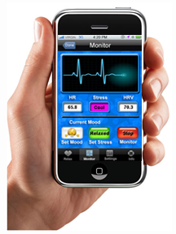
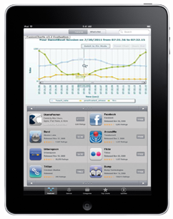

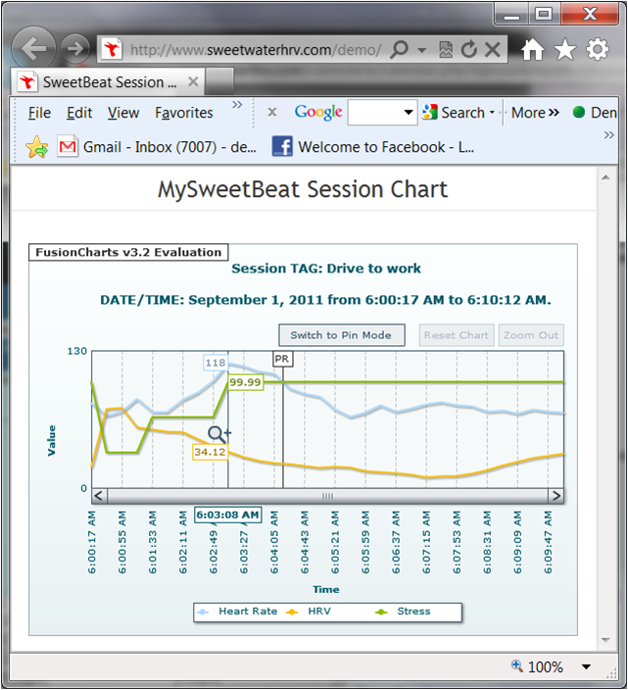
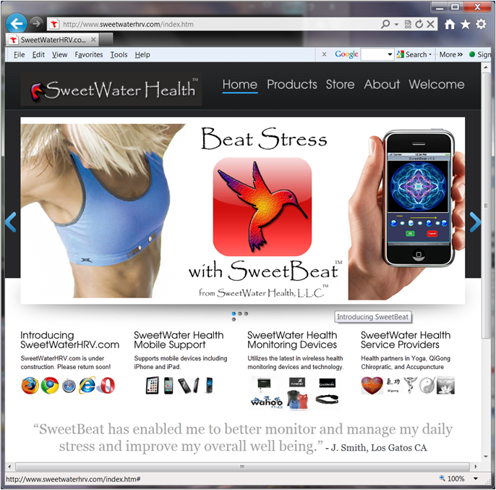
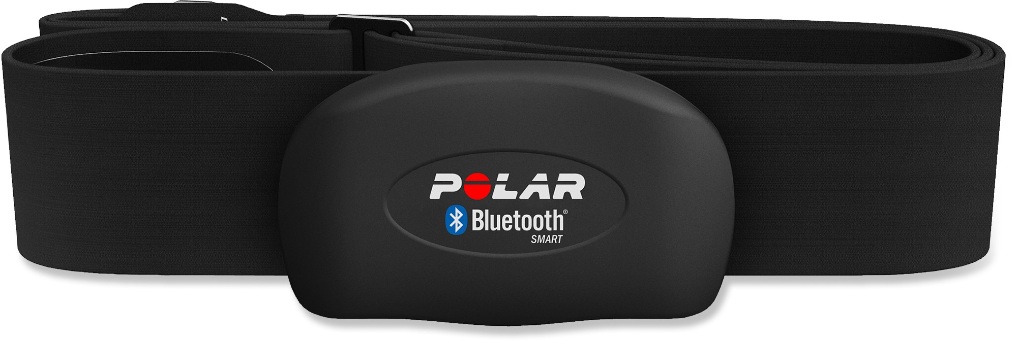
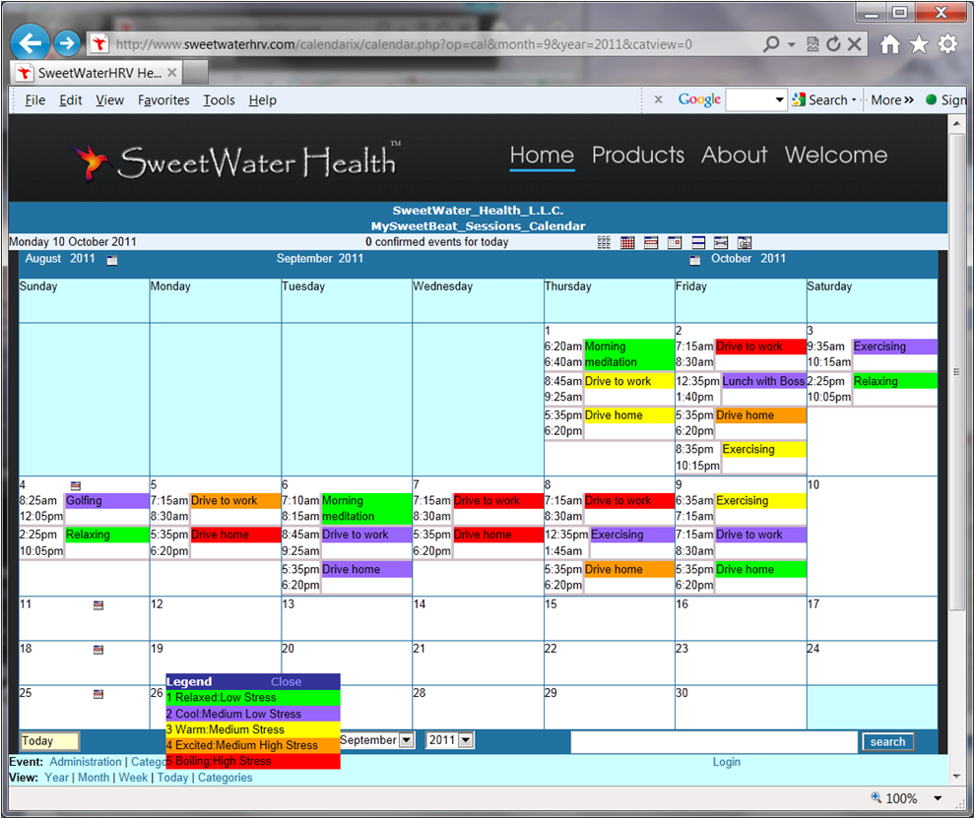



The SweetWater Health HRV Solution
SweetBeat Pro Mobile App
Powered by proprietary SWH
mHealth software algorithms
Leveraging innovations in mobile
and health monitoring devices
Web Health Analysis Tools
Powered by SWH vital signs
mHealth databases and API’s
Leveraging advances in
web and cloud technology
SWH Vital Signs
Databases
Powered by proprietary SWH
software technology
Leveraging secure & scalable
Amazon Web Services
Persistent Storage
LAMP Servers
Notes:
The SWH solution includes mobile applications that utilize existing and emerging vital sign sensor devices and clothing
Our first mobile app, SweetBeat, is a stress detection and management app and forms the basis for our suite of health monitoring and diagnostic mobile apps
Our web and database solutions provide applications for individuals and health professionals to analyze and track vital signs and form diagnosis for disease
Our database mining solutions will evolve into modules that integrate seamlessly into existing and established EHR and Wellness software packages
We currently use AWS cloud computing for scalable and secure data storage and compute resources
Leverage emerging mobile platforms, biosensors and cloud computing to develop affordable and accessible health monitoring solutions
SweetWater provides a cost effective solution for remote patient monitoring as well as individual wellness and health improvement monitoring
The SweetWater solution provides a non-invasive, ongoing means of measuring the efficacy of wellness initiatives as well as employee compliance with corporate wellness programs
The state of the ANS and thus HRV can be used in diagnosis and monitoring of treatment effectiveness for a variety of conditions such as:
Stress Anxiety, Panic Disorder and Depression
Heart Disease
Hypotension by infection onset in critically ill patients
Early detection and ensuing treatment of autonomic neuropathy in diabetic patients
Collection of raw ECG and Pulse data provides means for arrhythmia detection and vascular analysisombining leading edge technologies with our own proprietary software to create and integrated consumer friendly mHealth monitoring and health improvement ecosystem

Slide 6
The SweetBeat Pro Solution
SweetBeat Pro HRV analysis app is available for iPhone, iPad and iPod Touch
Convenient and cost effective
User interface and tools customized for your Chiropractic practice
Import data from select Bluetooth enabled Scales, Blood pressure monitors, activity monitors, and glucometers to track total health
Secure cloud storage of data
Advanced web based health analysis toolkit
Serves as an electronic record database for Chiropractors who are currently using paper charts
Interface to select Electronic Health Records (Practice Fusion) for those who have migrated to EHRs.
Notes:
Jo Beth Dow and I founded SWH in Feb, 2011
While we develop apps as part of our product, we are a software technology company
Our mission is to analyze the patterns of the heart beat, known as Heart Rate Variability, AND the patterns of Heart Rate Variability to detect onset of specific conditions
The app and mobile platform serves as a real time detection device and as a data collection platform that utilizes 3rd party sensors and heart rate monitors.
Our backend database is mined and advanced analytics are utilized to detect disease specific patterns in the data
A rich and graphical tool suite brings the data to life with application specific functionality and user interfaces

Slide 7
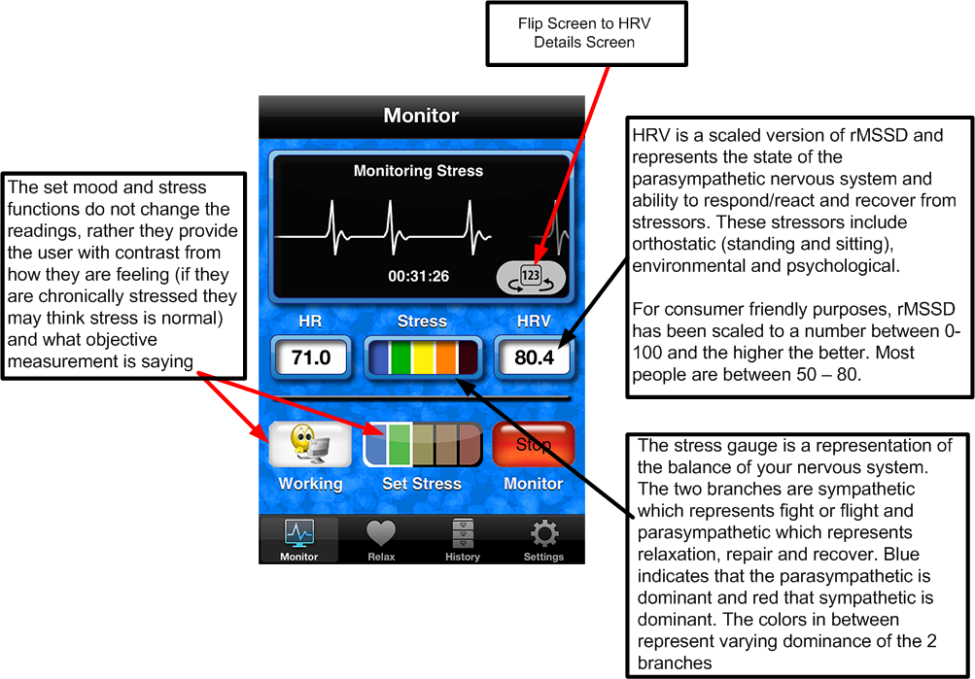
SweetBeat Display Description

Slide 8
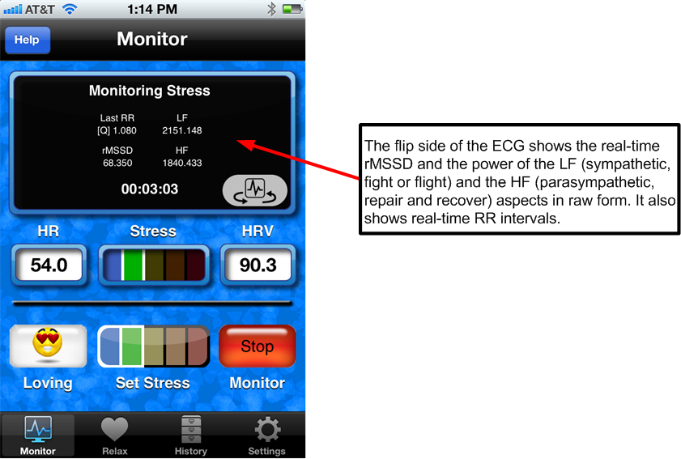
SweetBeat “Stats for Nerds”

Slide 9
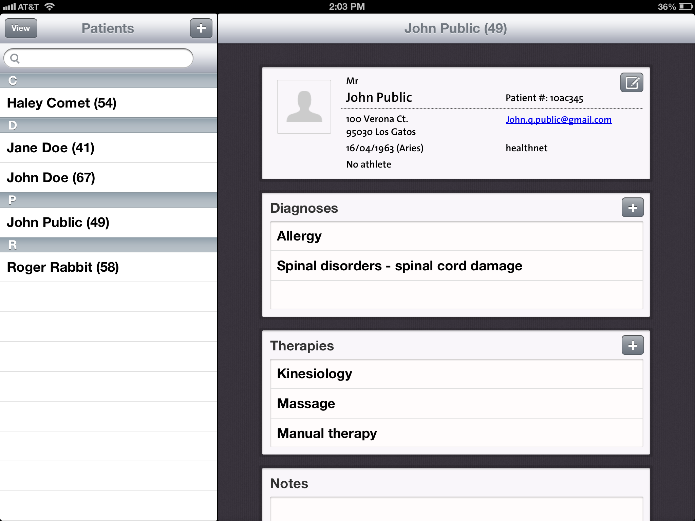
SweetBeat Pro Patient Information

Slide 10
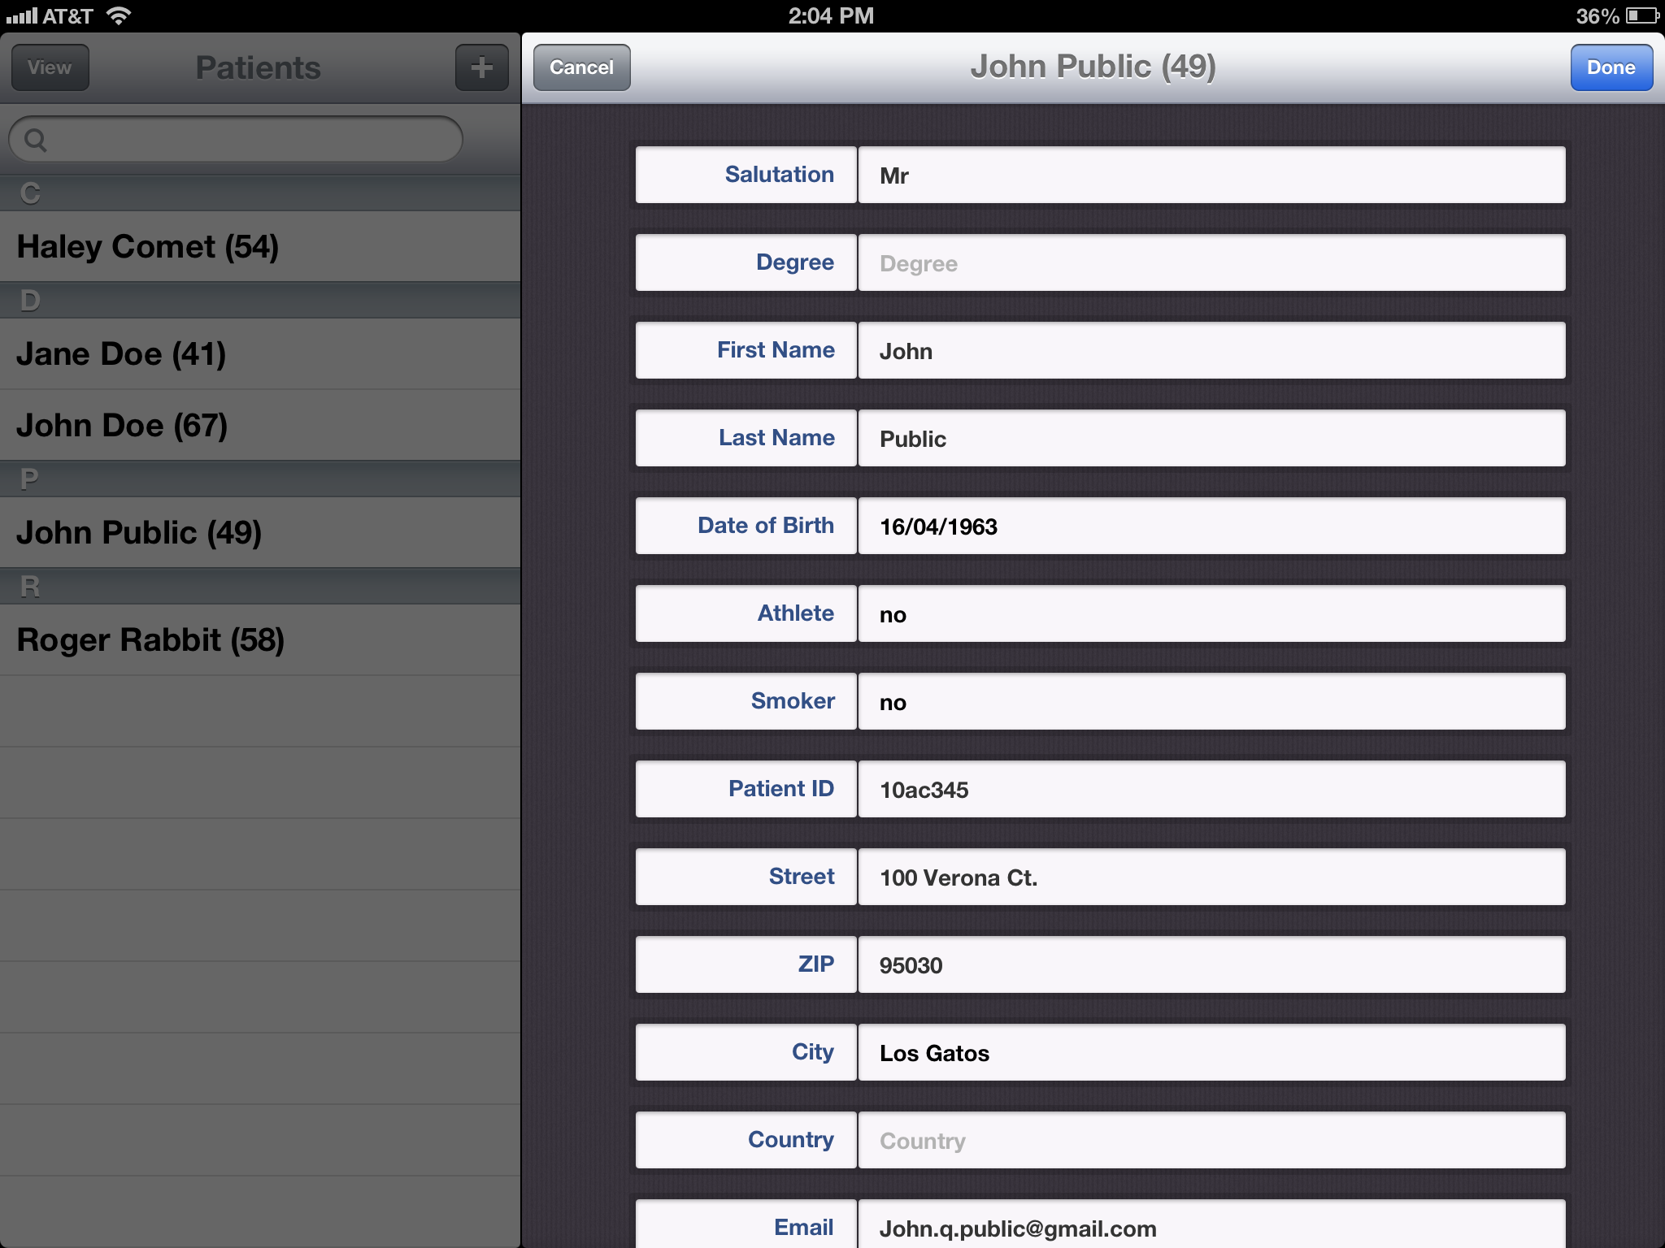
Patient Details

Slide 11
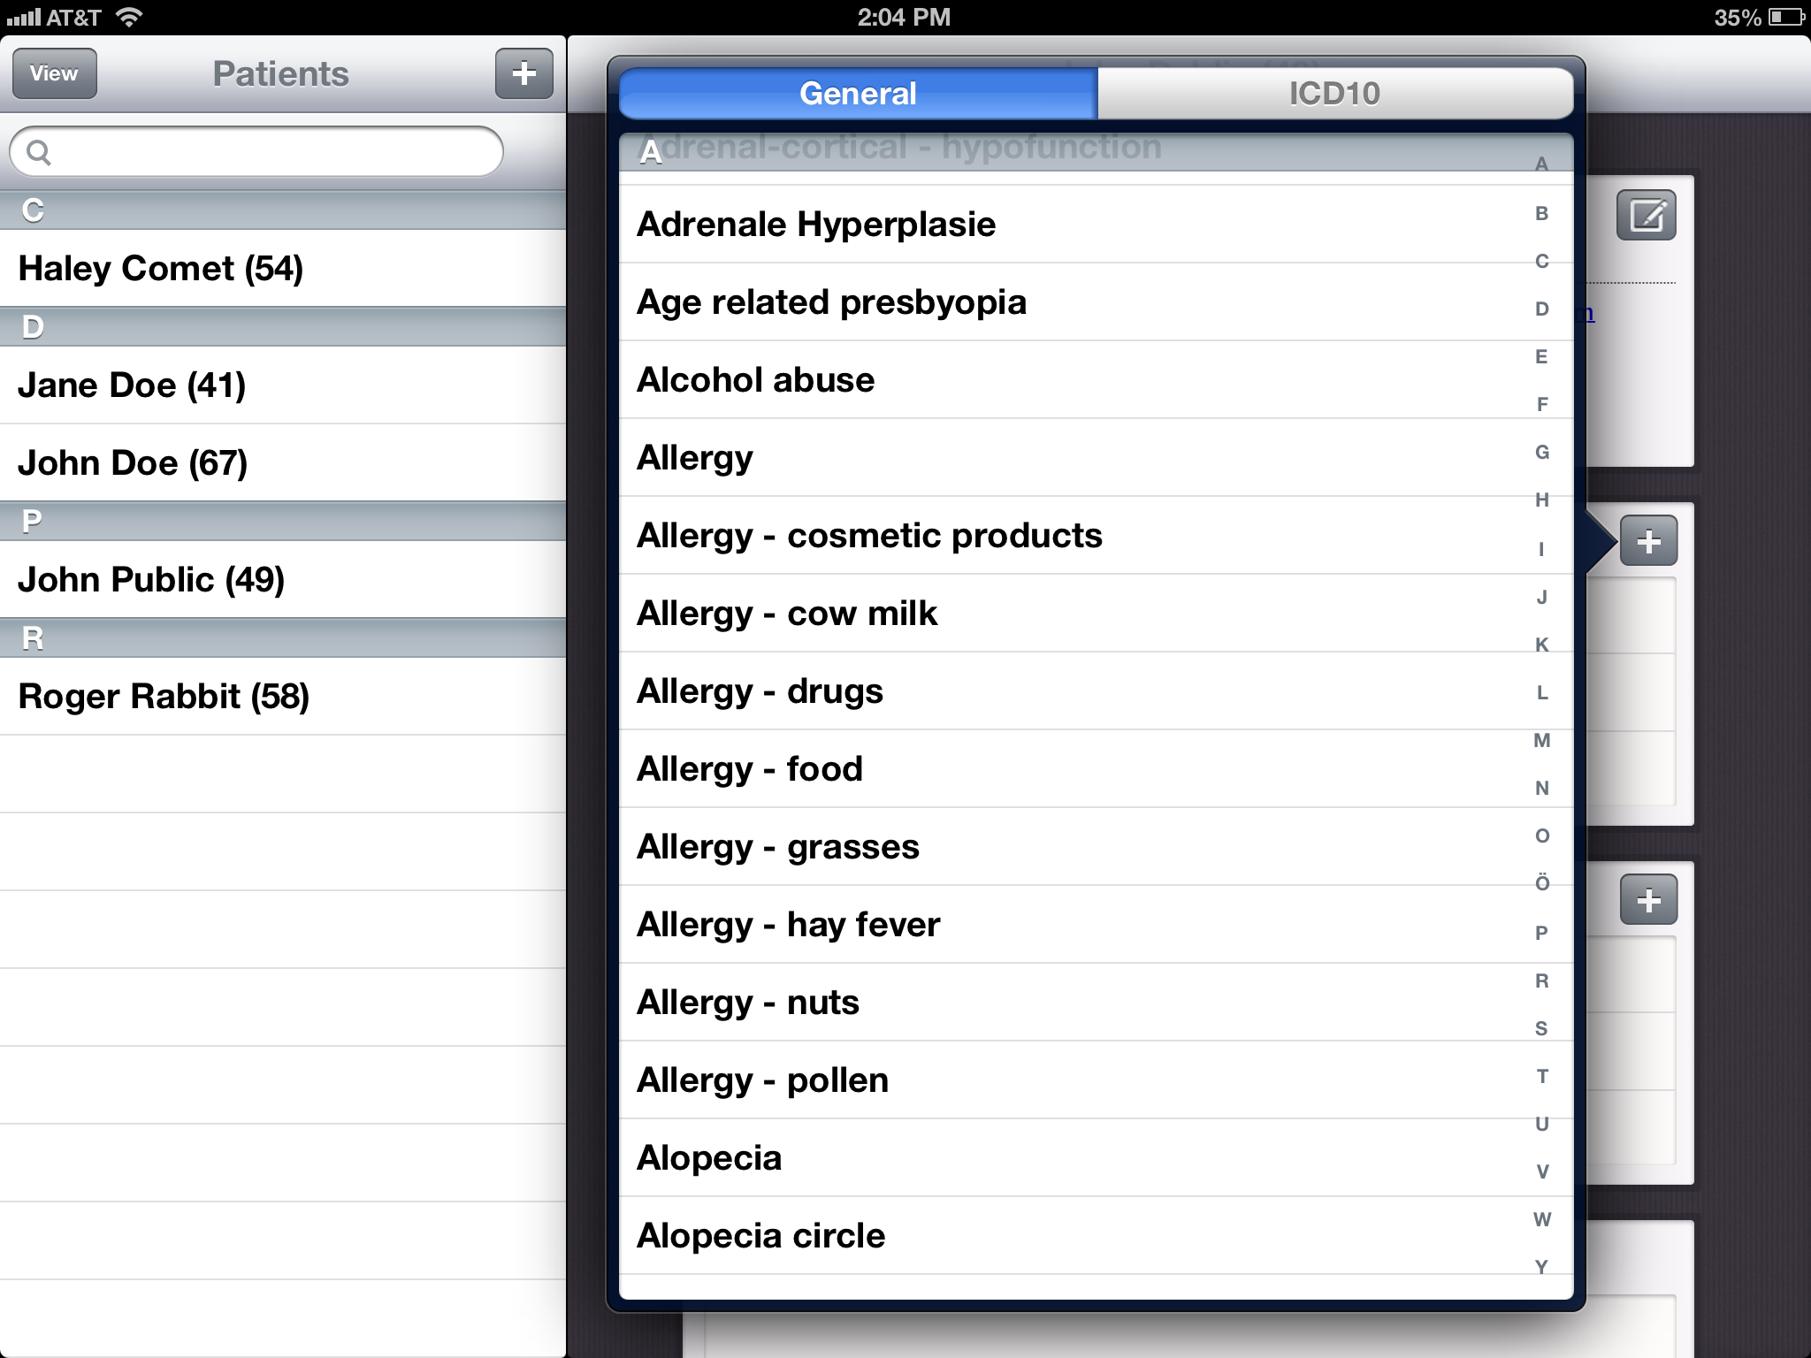
Diagnosis Menu

Slide 12
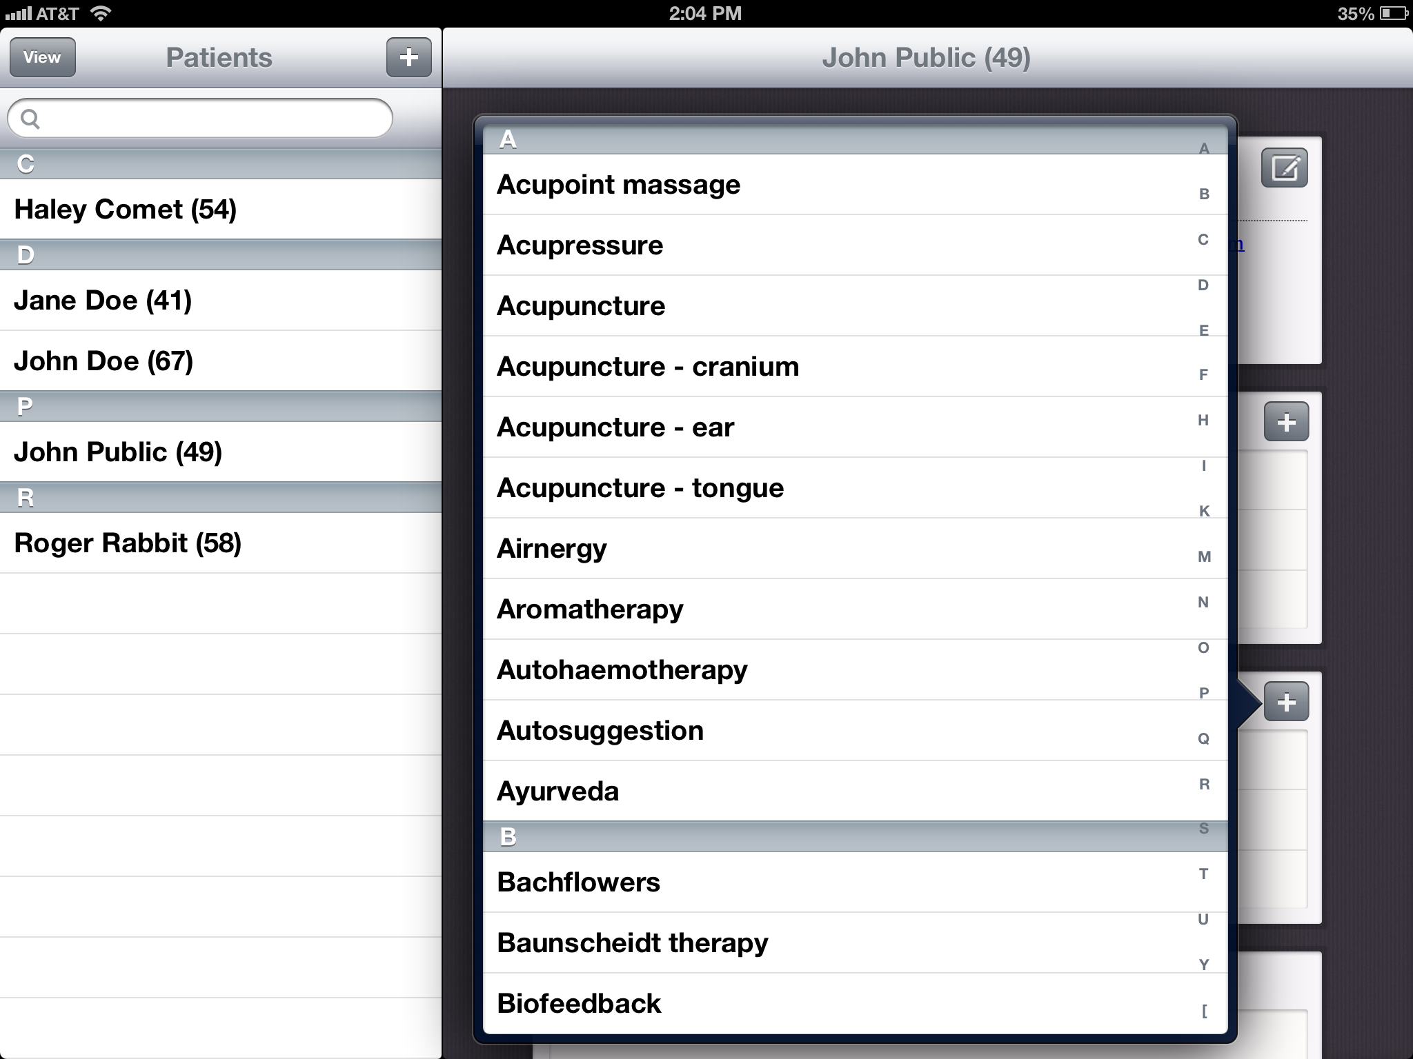
Treatment Menu

Slide 13
HRV Results and Recommendations
Each chart comes with
detailed description and
specific treatment
recommendations

Slide 14
Getting Started
Q: How much will this cost?
A: It depends on your practice size and venue. If you have a single adjustment room and wifi in your office you will need:
  One 8GB iPod Touch ($187.99) or iPad ($329)
  One SweetBeat Application ($299.99)
  One heart monitor and receiver/dongle ($59.99 - $99.99)
  A SweetBeat Pro subscription ($29.99/Month/10 patients)
Q: If I want multiple setups what is the additional cost?
A: The additional cost will be for the mobile platform (iPod, iPad or iPhone) and the heart rate monitor hardware. The app may be loaded on multiple devices and the subscription is based on the number of patients, not the number of platforms
Q: What if I don’t have wifi?
A: If your office does not have wifi, you need a 3G or 4G enabled mobile platform such as iPad or iPhone

Slide 15
Measuring Patient HRV
Q: When do I measure HRV and how long will it take?
A: It is recommended that you run a 5 minute HRV session:
  During a new patient evaluation, before any adjustments
  Before adjustments in order to plan treatment
  After adjustment to measure effects of treatment
Q: What is involved in running a session?
A: Your patient will attach an athletic chest strap heart rate monitor
  Attach the heart rate receiver to your iphone/ipad/ipod if applicable
  Launch the SweetBeat Pro app
  Select the patient from your patient list
  Press start and wait 5 minutes
  You may watch the HRV in real time and view results in text or graphical form when complete
  Add notes to the session and upload
Q: Does the patient just sit there during a session?
A: There are several tests you can perform:
  Basic reading – patient relaxes and breathes normally
  Orthostatic testing – patient lies supine and the stands
  Deep Breathing testing – Patient does deep breathing by following the SweetBeat Pro breath pacer

Slide 16
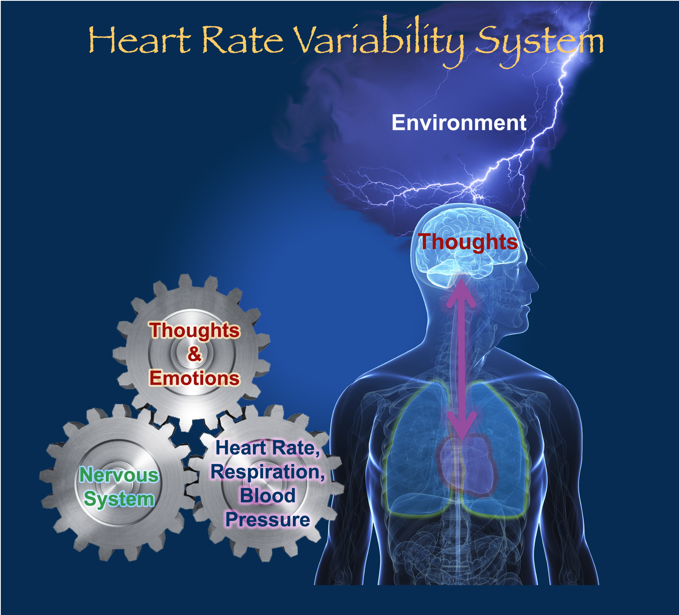



The Science of HRV
What is Heart Rate Variability (HRV)?
HRV is The variation between each heart beat and is a view into the ANS
This illustration shows an unhealthy heart rate variability with constant 1 sec intervals between beats
This illustration shows a healthy heart rate variability with variation between beats
This variation is caused by the sympathetic nervous system speeding the heart up while the parasympathetic slows it down in a sort of “tug of war”
HRV has been researched for more than 30 years
Notes:
HRV is The variation between each heart beat and is a view into the ANS
30 years of research validates HRV as a significant metric for measuring health
HRV is a mainstream topic of research
Some HRV metrics
SDNN – Standard Deviation of RR intervals
pNN50 – Percentage of RR intervals/hour in which change in normal intervals exceeds 50msec
rMSSD – Root Mean Square of Successive Differences of RR intervals
SDNN, pNN50, rMSSD all have published cutoff points for risk of sudden death from MI
HRV provides insight into the nature of heart-related diseases
While there is still a gap in awareness of HRV between researchers and doctors in the medical community, HRV is an emerging biometric
Insurance reimbursement codes accept HRV as a metric for measuring ANS
Monitoring HRV allows individual to modify behavior, leading to positive change throughout the body’s tightly coupled system
HRV measurements.
CPT Coding 95921 and 95922
Two reimbursable CPT codes allow physicians to be paid for autonomic nervous system monitoring.
These two reimbursable CPT codes for autonomic nervous system monitoring (95921 and 95922) were established in 1999. These CPT codes enable health care providers to be reimbursed for monitoring the autonomic nervous systems of patients where such monitoring is indicated.
The reason for two CPT codes is simple. In order for physicians to get a complete look at autonomic nervous system functioning they must read both of its branches (Sympathetic and Parasympathetic) independently.
CPT code 95921 is coded for parasympathetic nervous system monitoring and 95922 is coded for sympathetic nervous system monitoring.
HRV measurements. CPT Coding 95921 and 95922
357.2 Polyneuropathy in Diabetes
V628.9 Psychological Stress or Physical Stress not elsewhere classified
308 Stress Reactional Emotional
308.1 Predominant disturbance of consciousness
308.3 Other acute reactions to Stress
308.4 Mixed disorders as reaction to stress
308.9 Unspecified acute reaction to stress
458 Orthostatic Hypotension
458.1 Chronic Hypotension
429.9 Heart Disease unspecified

Slide 17
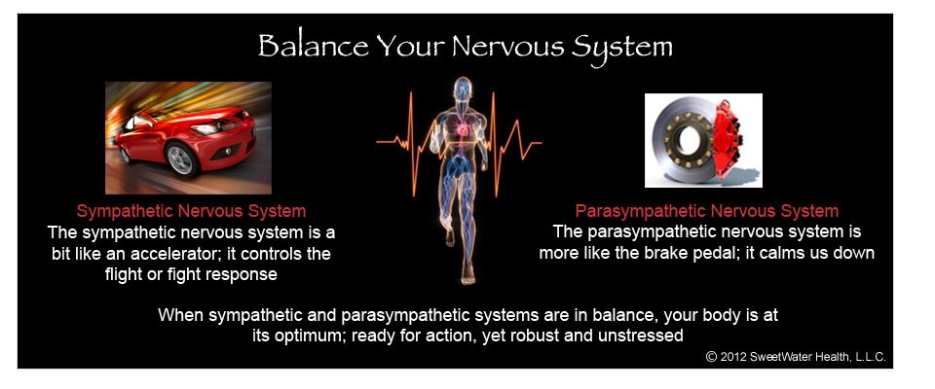
Benefits of SweetBeat
Continuous real-time generative feedback

Slide 18
SweetWater Health
HRV Parameters
Heart Rate Variability is measured by several parameters:
Time domain – These are standard statistical analysis of the heart beat time series
  Standard Deviation (SDNN)
  Root Mean Square of Successive Differences, (rMSSD)
  Heart Rate (HR)
  pNN50, TINN, Triangular index
Frequency Domain:
  Very Low Frequency (VLF)
  Low Frequency (LF, associated with sympathetic activation)
  High Frequency (HF, associated with parasympathetic activation)
  Non-Linear:
    SD1/SD2, ApEn, SampEN
  SweetBeat uses HRV algorithms provided by Physionet (Harvard-MIT Division of Health Sciences and Technology

Slide 19
SweetWater Health
HRV and Vagal Tone
The vagus nerve is the 10th of 12 paired cranial nerves and controls parasympathetic innervation of the heart and acts to lower the heart rate.
Vagal innervation is the mediator of HRV and therefore HRV is an indication of Vagal Tone
  The higher the HRV, the stronger the Vagal Tone
Higher HRV is an indication of an individuals ability to “put the brakes on stress” by mediating the sympathetic control over the nervous system and heart rate.
HRV is “the thickness of your brake pads” in stopping stress and recovering to a balanced state
HRV may change day to day with your biorhythm or due to emotional or physical stress
Chronic low HRV is an indication of systemic health (psychological or physical) issues
There are over 5,000 papers on HRV in the NIH database alone
There are CPT reimbursement codes for HRV measurements
Studies have shown that a plethora of health issues result in reduced HRV
Notes:
Jo Beth Dow and I founded SWH in Feb, 2011
While we develop apps as part of our product, we are a software technology company
Our mission is to analyze the patterns of the heart beat, known as Heart Rate Variability, AND the patterns of Heart Rate Variability to detect onset of specific conditions
The app and mobile platform serves as a real time detection device and as a data collection platform that utilizes 3rd party sensors and heart rate monitors.
Our backend database is mined and advanced analytics are utilized to detect disease specific patterns in the data
A rich and graphical tool suite brings the data to life with application specific functionality and user interfaces

Slide 20
SweetWater Health
SweetBeat HRV
It turns out the rMSSD is a reflection of Vagal Tone
rMSSD is non-stationary and varies +/- 10 ms at rest
Average rMSSD ranges from ~20ms to ~80ms depending on age and state of health
  SweetBeat measures rMSSD
SweetBeat then scales rMSSD to a range that people are familiar with; 0 – 100
  This is aligned with iThlete’s consumer presentation of rMSSD
So a high HRV means a high rMSSD which means strong Vagal Tone
  Ability to put the brakes on stress
  Indication of systemic health

