Slide 1
SweetBeat and Chiropractic Care
SweetBeat and Chiropractic Care

Slide 2
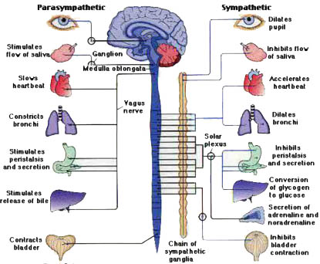
SweetBeat Monitors
the Nervous System
The Autonomic Nervous System (ANS)
Chiropractic is for the optimum functioning of the nervous system; imagine showing your clients exactly how and when you are making positive adjustments to their nervous systems. This will increase patient satisfaction by demonstrating success of the chiropractic treatment.
A flexible ANS gives a high HRV reading!
Source: biocomtech.com
2

Slide 3
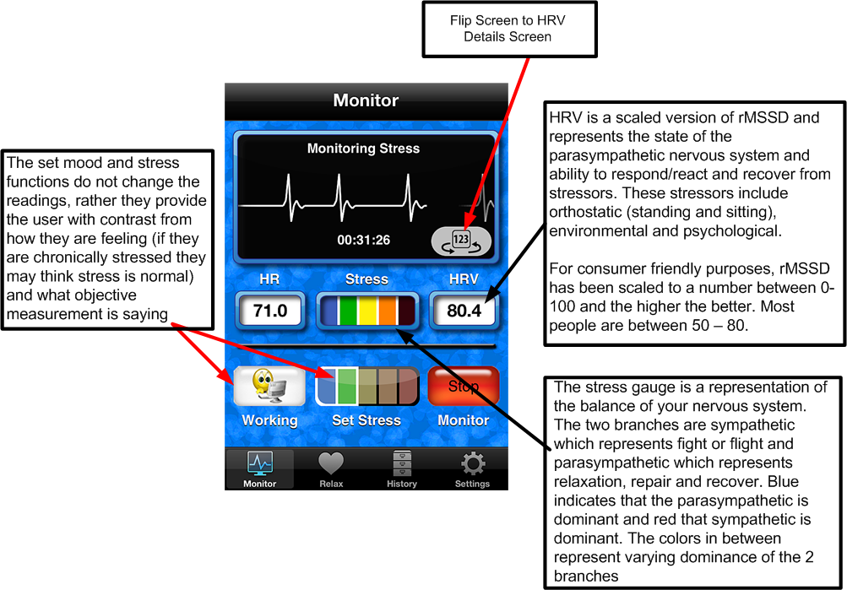
SweetBeat Display Description
Source: SweetWater Health LLC
3

Slide 4
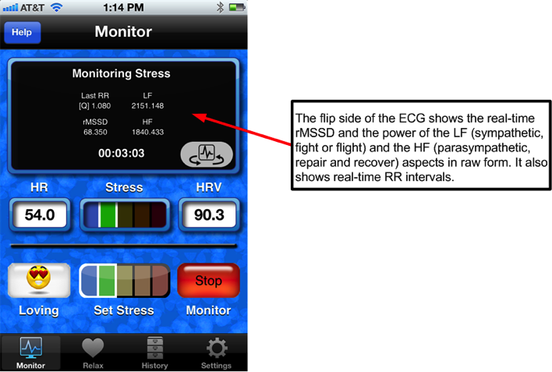
SweetBeat Stats
Source: SweetWater Health LLC
4

Slide 5
MySweetBeat Tracking Tools
Source: SweetWater Health LLC
5

Slide 6

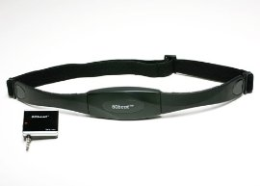
Implementation
Buy enough equipment for your office
For an office with three adjustment rooms:
Three 8GB iPod Touches ($187.99 each)
Three SweetBeat app downloads ($1.99 each)
Three 60Beat heart monitors and receivers/dongles ($59.99 each)
Subscription to MySweetBeat Web Portal ($29.99) = discounted price of $719.90
6

Slide 7
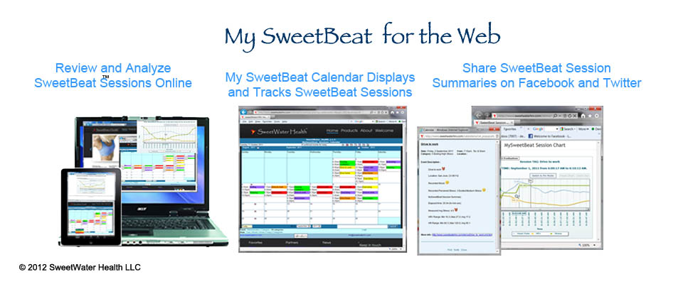
Implementation
Before an adjustment, have the patient put on the heart rate monitor strap and run a five-minute SweetBeat session to see the patient’s HRV and stress numbers. After the adjustment, run another five-minute session and note the changes.
Create an account and upload sessions to the private and secure MySweetBeat database. If you wish, you may create separate accounts for each client. The other option is to save the sessions as the client’s name or email.
7

Slide 8
SweetBeat Benefits
With the SweetBeat app and the secure MySweetBeat portal, you will be able to:
Use an accurate HRV reading to assess the baseline of a patient’s resting state versus their pain levels
Measure a particular client’s HRV before and after the chiropractic session.
Recommend SweetBeat to your patients to measure HRV between chiropractic sessions, encouraging them to keep an eye on stress throughout the week.
Measure their HRV during a chiropractic session to measure efficacy.
Upload individual client HRV sessions to MySweetBeat for tracking and review.
E-mail your patients their session summaries from previous sessions.
8

Slide 9
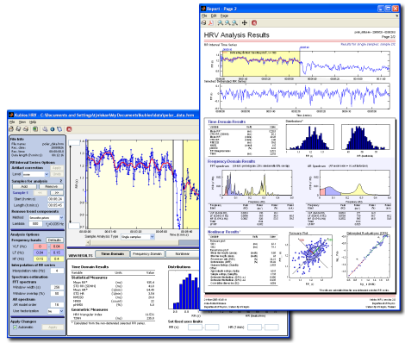
Kubios
If you are interested in using the data received from SweetBeat to analyze the data even further, we recommend the freeware, Kubios. While this is a separate program from ours, you may obtain more information on HRV analysis by visiting the Kubios website at http://kubios.uku.fi/
9

