Slide 1

SweetWater Health
HealthCheckHRV
Quickstart Guide
SweetWater Health
TM
BeatHealthy
TM
January, 2015

Slide 2
Welcome!
SweetBeatHealth provides you with an accurate assessment of your overall health and resilience. Our clinical grade algorithms measure Heart Rate Variability (HRV) and provide you with intuitive and easy to understand health status.
When tracking your health, we recommend doing regular sessions – daily, weekly or monthly depending upon your goals.
If you are trying to create new habits, we recommend a daily reading so that you will know your willpower reserve for the day and can plan accordingly. Research shows that HRV is correlated with willpower. So stay on track by understanding Willpower and HRV.
If you are keeping an eye on your overall health, do a session once a week or once a month! What is important is to chose a schedule that you can stick to!
Since HRV has a natural 24 hour variation, try to do you sessions at the same time of the day. Otherwise you will comparing apples to oranges. We recommend first thing in the morning before you eat or have coffee/tea.

Slide 3
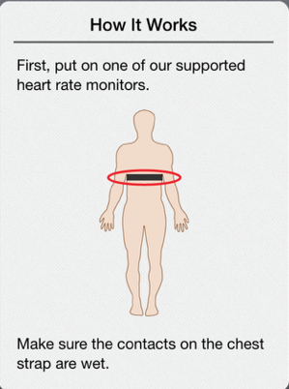
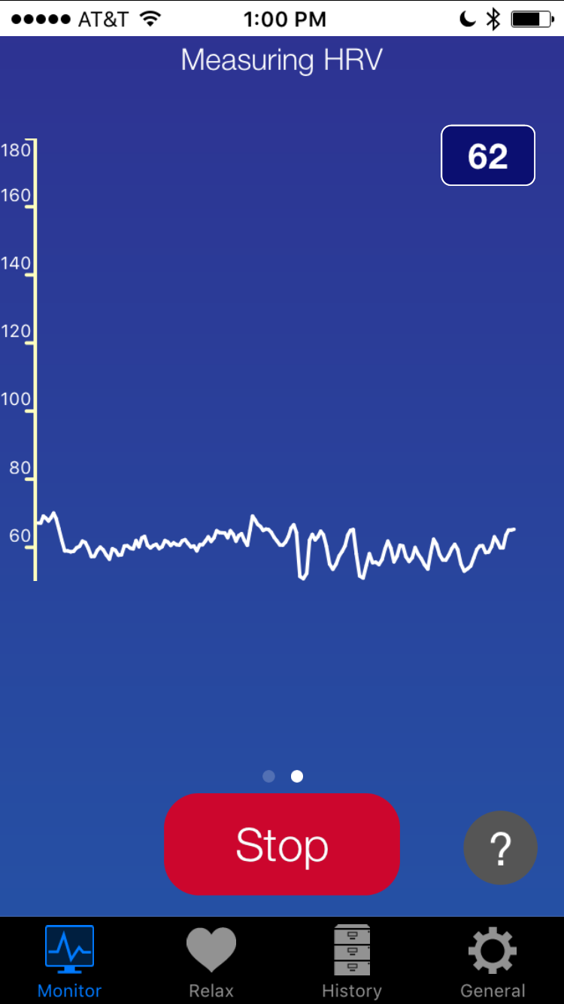
Getting Started
Next pair the Heart Rate Monitor by selecting the “General” icon on
The main screen then select Heart Rate Monitors->Bluetooth Smart.
The app will scan for your monitor. When it is displayed in the list, tap
It to pair.

Slide 4
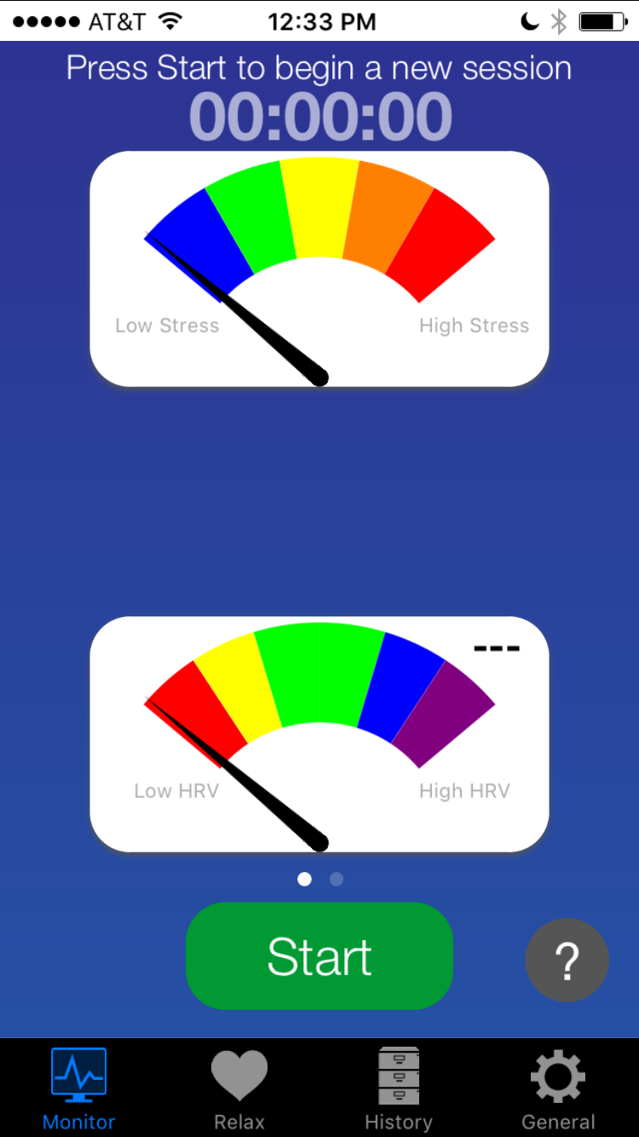
Getting Started
Once your Heart Rate Monitor is Paired, press Start
Note: If it is your first time, you will be prompted to set your daily reminder time. You may turn this off later by selecting the General tab -> App settings.

Slide 5
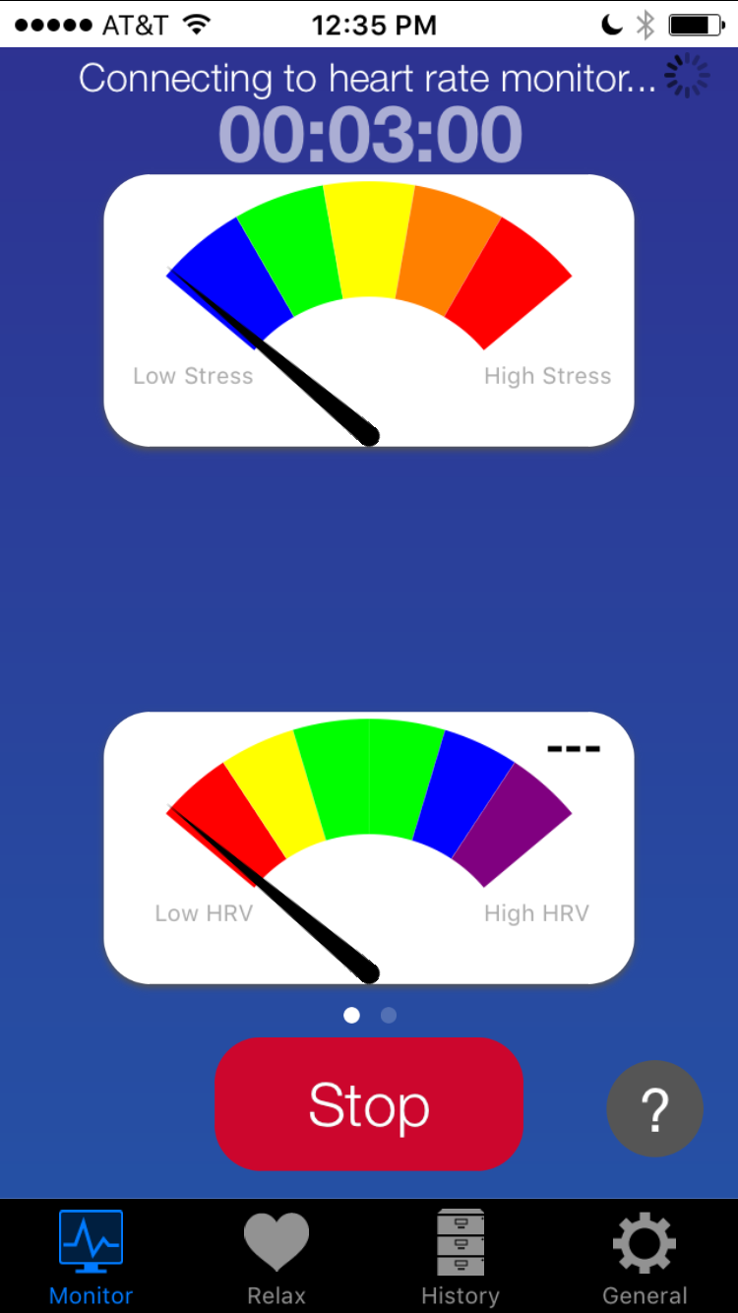
Getting Started
SweetBeatHealth will attempt to connect to your Heart Rate Monitor and you will see “Connecting to Heart Rate Monitor at the top.

Slide 6
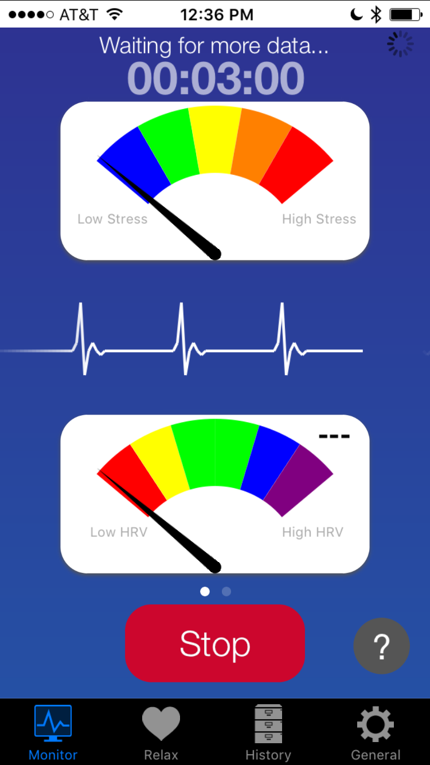
Getting Started
After it is connected to your heart rate monitor, it will begin collecting data for up to 45 seconds and you will see “Waiting for more data” at the top of the screen. This is for the clinical grade processing in action!

Slide 7
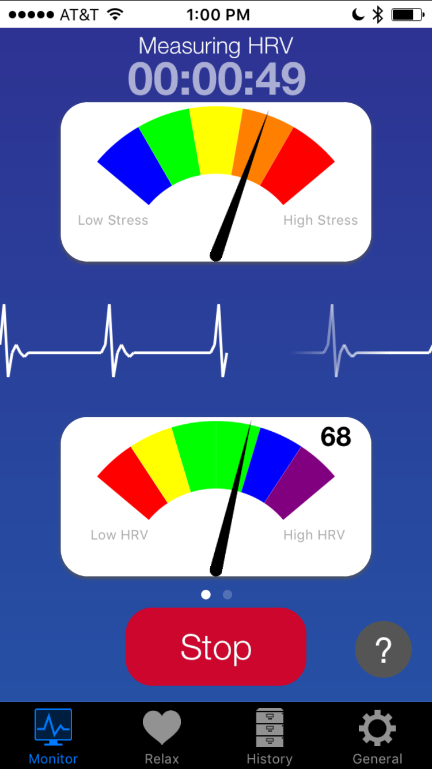
Getting Started
Once enough data has been collected, your stress level and HRV will be displayed and the session timer will count down to the end of the session. You may terminate your session early (not recommended) by pressing Stop.
You can switch to your beat to beat heart rate screen by swiping right to left and return to the main screen by once again swiping right to left.

Slide 8
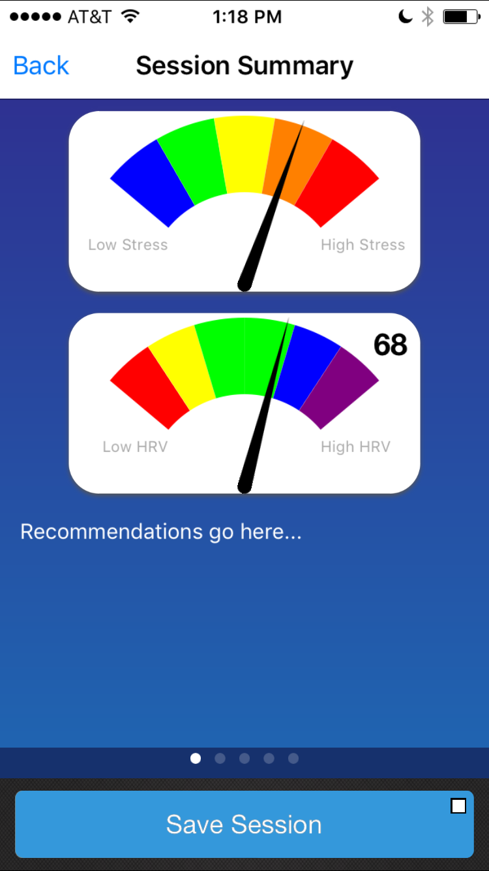
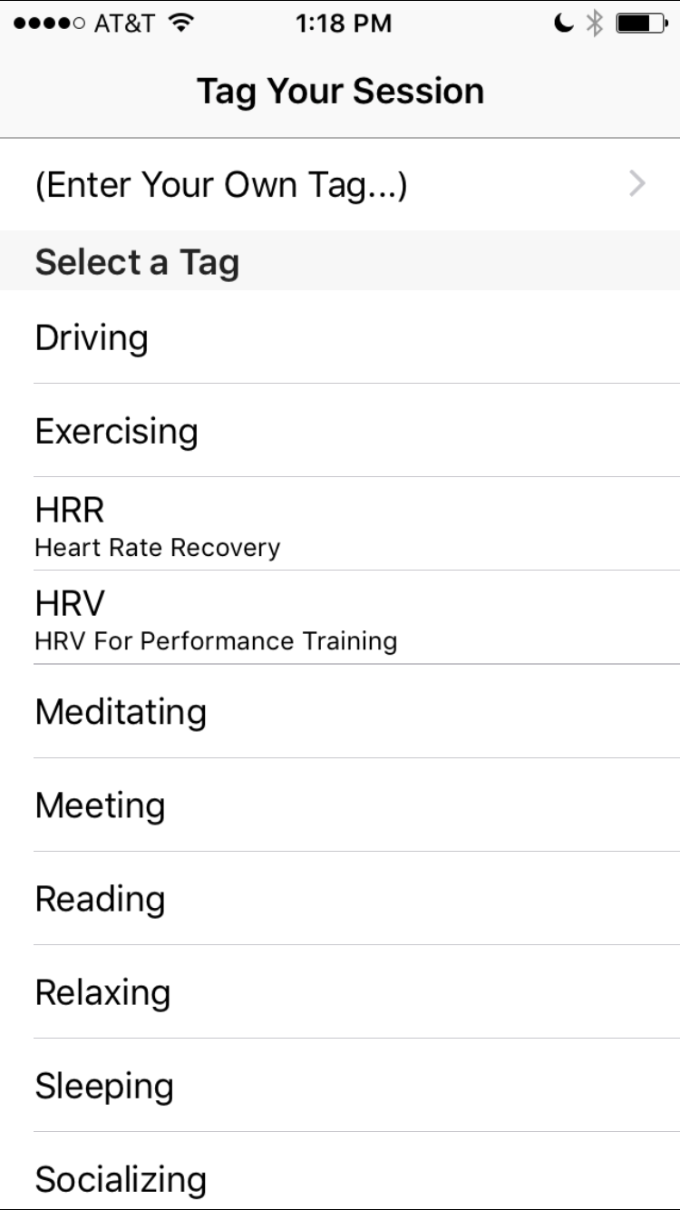
Getting Started
At the end of the 3 (5) minute session, the session summary will automatically be displayed. Select “Save Session”.
A “Tag” screen will appear and allow you to select from the canned tags or type in your own custom tag.

Slide 9
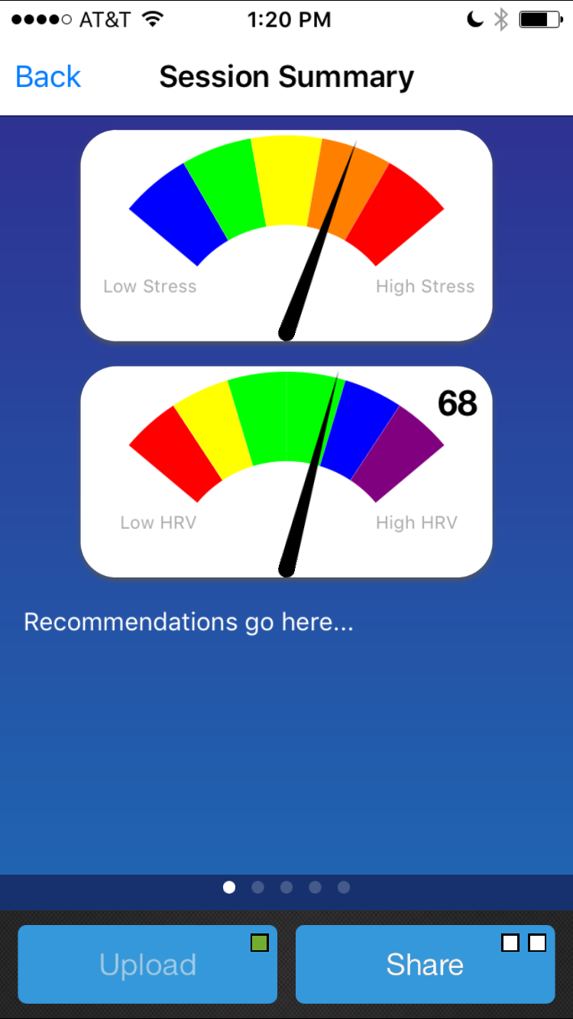
Getting Started
Assuming you have created an account and logged in, your session will be automatically uploaded as indicated by the green square in the upload button. If you are not logged in it will be saved on your phone/tablet and you can upload it later.
You can share your session on Facebook and Twitter or email the results by selecting the “Share” button.

Slide 10
“Gauge Page” Recommendations
Orange-Red Stress, Blue-Purple HRV
  Your stress and your HRV are high today which could be an indication of “Eustress” or good stress. This could be a great day to get stuff done and initiate a project or complete something you have been procrastinating.
Yellow Stress, Blue-Purple HRV
  Your stress is average and your HRV is high and this could be a great day for creative work and working with others. You are invigorated and balanced!
Blue-Green Stress, Blue-Purple HRV
  Your stress is low and your HRV is high indicating that this could be an awesome day for working solo on creative or focus intensive projects. The low stress means your brain is online for detailed work and high HRV means you have the power behind the focus.

Slide 11
“Gauge Page” Recommendations
Orange-Red Stress, Green HRV
  Your stress is high and your HRV is good today which could be an indication of moderate “Eustress” or good stress, depending on how your are feeling. If you feel good then start a new project or finish up an existing one. Get some exercise even if it is just a short walk.
Yellow Stress, Green HRV
  Your stress and HRV are average so go for it and have a great day! Avoid traffic and stressful people and go socialize at some point with people you enjoy. Watch a funny movie tonight if possible
Blue-Green Stress, Green HRV
  Your stress is low and your HRV is good! This could be an excellent day for working solo work that is of moderate intensity. The low stress means your brain is online for focused work and medium HRV means you have a reasonable amount of energy to power your efforts.

Slide 12
“Gauge Page” Recommendations
Orange-Red Stress, Red-Yellow HRV
  Your stress is high and your HRV is low today indicating a chance of a stressful day ahead. Did you get a good nights sleep? Avoid traffic today and do busy work that does not require a lot of focus or interaction with confrontational people.
Yellow Stress, Red-Yellow HRV
  Your stress is moderate and HRV is low. This could be a medium energy day. Go about your usual day though take it easy when possible. Go for a walk, do some deep breathing and get a good night’s sleep tonight.
Blue-Green Stress, Red-Yellow HRV
  Your stress and your HRV is low which could indicate a low energy day for you. Leave plenty of time to get places so you do not need to hurry or worry, take a nap if possible and be sure to get some sort of exercise. Get to bed early tonight and avoid alcohol which suppresses the nervous system.

Slide 13
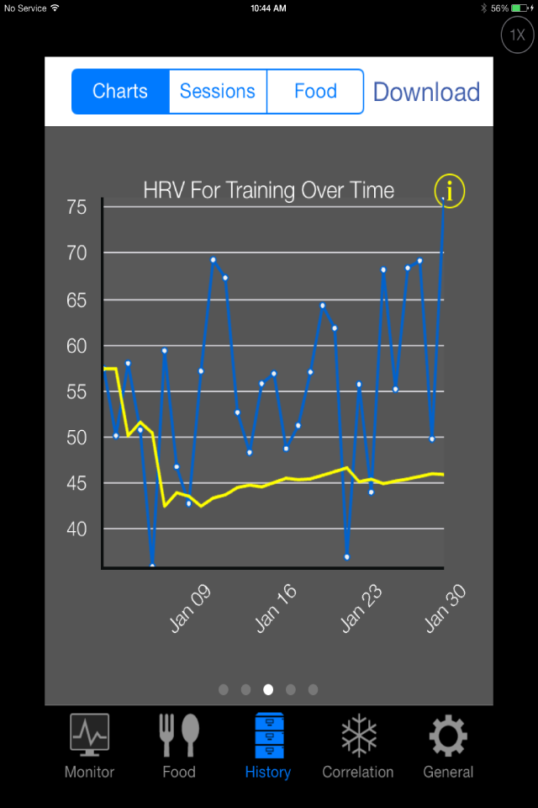
Session Summary Reports
Now swipe right to left to see your session summary reports!
The first screen is your “TBD” screen and shows how your health from this session compares to your previous sessions. If you are above your reference line you ready to take on the world! If you are below your reference line then you are having a low energy day. You need a few sessions for this to make sense!

Slide 14
Willpower Recommendations
Below reference line 1 day
  Your will power has fallen. Stick to your goals though lay low, avoid stressful situations if possible. Do some deep breathing or meditation today and avoid confrontational people.
Below reference line 2 or more days
  Your will power has not recovered. Stick to just one of your goals today and if possible do busy work today and take a nap or do a short meditation at lunch. Avoid stressful situations at all costs.
Above your reference line
  Your will power is great today! Stick to all of your goals! This is also an excellent day for creative work and working with others. As usual though focus on desired behavior patterns and hang with positive people.

Slide 15
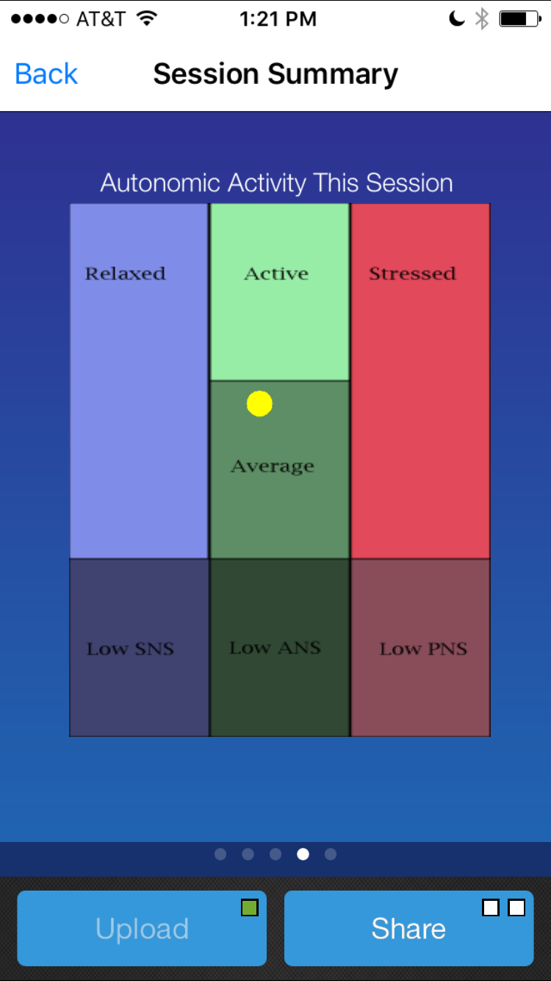
Session Summary Reports
Swipe again to see your Balance of Power chart. This chart shows your power and the balance of that power.
Your power is an indication of your overall energy and ability to adapt to daily events and recover from adversity. You could say it measures the volume of your life force.
Your balance tells you if you are on the relaxed or stressed side of life.

Slide 16
Power and Relaxed Recommendations
Your powered up today in a mellow sort of way. This could be a great day get some rigorous exercise or tackle that project you have been putting off.
Congratulations! You are physically powered up with low “Fight or Flight” response! This means you can think clearly make careful decisions and have some level of immunity to stressful situations. So go do the things that otherwise might cause you stress.
Today your nervous system is in great shape and your “rest and digest” branch is dominant. Strive to maintain this state today. Remember, “nerves that fire together wire together” and returning to this state regularly can literally rewire you to withstand stress.
You are powerful! Your parasympathetic nervous system is dominating which means your brain is online! This could be a great day for focused and creative work in addition to enjoyable exercise!

Slide 17
Power and Balance Recommendations
Your powered up today and very balanced. Your “Fight or Flight” and “Rest and Digest” responses are in equilibrium. This is a great day to go about your usual routine with mindfulness and regular deep breathing to maintain this excellent state.
Congratulations! You are physically powered up with la balanced nervous system. This means you can think clearly make careful decisions and have some “Umph” to handle whatever the day brings. Get some exercise today and eat only organic whole foods today to try to maintain the excellent state.
Today your nervous system is in great shape and your “rest and digest” branch is balanced with your “Fight or Flight”. Strive to maintain this state today. Don’t let things get to you and take deep breaths if they do. Choose calm happy people and even sneak in a 10 minute meditation.
You are powerful! Your nervous system is rockin’ which means your brain is online and you are particularly resilient! This could be a good day to have that difficult conversation or do a few chores you have been putting off.

Slide 18
Ready for Action Recommendations
Your powered up today and “Fight or Flight” response is dominant. This could be a great day or a stressful day, depending on how you chooses use this powerful condition. Be extra mindful in traffic, with difficult people and other situations that can tip you toward stress.
This combination of high power and Fight or Flight could mean a day of good stress known as “Eustress”. This means you are enthusiastic and ready to take on the world. Start your day with a Eustress mentality, get stuff done then come home and get to bed early. What a great day!
You are healthy, powerful and wise! On this high power Fight or Flight day focus on enthusiasm not frustration. Can do instead of can’t do. Acceptance verses Resistance. Use this power to create a great day!
You are powerful! Your nervous system is “on fire” so harness this energy wisely. If you start to feel stress, get out and exercise then treat yourself to an organic healthy meal. If you feel great, be sure to move slowly and efficiently not hurried and hastily. Stay in the good “Eustress” zone!

Slide 19
Relaxed and Chilled Recommendations
You are in good condition! Your power is good and your “Rest and Digest” is dominant which means you are more likely to think clear and make good decisions. This is a great day for working with others and hashing out ideas. Try to get some exercise! Bring a friend and have fun with it!
You are ready to receive all that life has to offer! Your relaxed and chilled state today is excellent for contemplation and meditation. Spend a few moments write down you goals for the day or week then feel the excitement of having completed them.
Today you are in an excellent relaxed state. Your power is good and so this is a great day notice the daily hassles that often stress you out. Consider whether these hassles are worth health problems? Probably not.
You are in a perfect power and relaxed zone today for paying attention to your inner state. Since you are relaxed, notice if you get butterflies in your stomach or feel anger and frustration try to creep in. Simply notice today.

Slide 20
Good to Go Recommendations
You are good to go! Your power is good and your nervous system is balanced. This is where most healthy people your age land so rejoice and have gratitude for your health and balance.
Your power is balanced today! Take a look in the mirror and thank yourself for taking care of your mind and body. Go about your day with gratitude for this most excellent health that you possess.
You deserve to be this balanced! Your power levels are great and the combination sets the stage for a day of variety while staying calm and yet ready for action! Get some exercise today and have a healthy organic meal.
Keep up the good work! Your power and balance are right where they should be for your age and gender! This is a great do for tasks that require calm and yet may require “turning on a dime”. This is a great day for meetings and planning with others.

Slide 21
Mild Stress Recommendations
Your power is good and you are showing signs of stress. Use SweetBeat session tags to help track events, emotions or physical symptoms that you can correlate with stress. Take a deep breath today rather than over react.
You are healthy and strong though have dominant Fight or Flight response today. Today is a good day to notice your triggers. Keeping a diary can help you identify repeating triggers for stress so that you can change them.
Your power is good and your stress response is elevated today. Stress is often contributed to by the media and news. Take a break and turn of the news for a week or two. If it is important you will hear about it.
Thank goodness for your health and take care today as you are showing signs of stress. Instead of “flipping your lid” take a time out. Stress allows the reptilian “reaction” brain to dominate the higher “reasoning” brain. So decide now to stay cool.

Slide 22
Low Power Recommendations
You may feel tired today. Consider how well you slept last night and how well you have been sleeping in general. Take a nap today and learn about “sleep hygiene” to get regular quality sleep.
Your nervous system is in low energy mode. Emotional stressors can wreak havoc on our mental and physical states. Be around positive people today, avoid the media and take a nap if possible.
Over activity can lead to physical burnout. Are you trying to do too much? Working out hard everyday? Take today off and spend relaxing time with yourself meditating or deep breathing. Take a walk in the park.
Nutrition can play a key role in feeling low. This includes skipping meals, craving sugar and carbs and making poor food choices that contribute to feeling low. Try eating organic whole foods and no processed foods for the next week and see how you feel.
Alcohol, even a little, can disrupt sleep and depress the nervous system. If you drink most nights try substituting herbal tea a few nights a week and see how that effects your sleep and morning energy.

Slide 23
Low Energy Recommendations
You seem balanced with low energy. Get some moderate exercise today, have a healthy dinner with plenty or fresh veggies, and go to bed early.
Your reading indicates a well balanced low key day ahead. Make it a point to eat healthy all day and hang around positive people who make you laugh.
While you are balanced today, your power levels are low. Did you sleep well last night? If possible take a 20 minute power nap to rejuvenate this afternoon.
If you find yourself pooped on a regular basis you could have a magnesium deficiency. Try adding a handful of almonds, hazelnuts or cashews to your diet to boost your magnesium intake.
Today your reading indicates good balance and low power. Be sure to have a good healthy breakfast today and include plenty of greens at lunch and dinner.

Slide 24
Grumpy or Anxious Recommendations
Your power is low and Fight or Flight is engaged. Positive Self-Talk helps reduce stress. Practice positive self-talk every day – in the car, at your desk, before you go to bed or whenever you notice negative thoughts.
High stress and low power are not your favorite days. Practice some “In the Moment” Stress reducing habits such as counting to 10 before you speak, taking long deep breaths or walking away from a volatile situation.
Increase your power and reduce your stress today! Engaging in pleasurable activities on a regular basis can counter your daily stressors. It is important to do things that make you happy and not let the stress prevent you from doing so.
Meditation has been clinically proven to reduce stress and actually change the brain waves to a more relaxed pattern. So take a few moments each day for quiet meditation, prayer or contemplation.
Time to boost your power and reduce your stress. Talking with family and friends and even your pets can help reduce stress in the body. Watch a funny movie tonight!

Slide 25
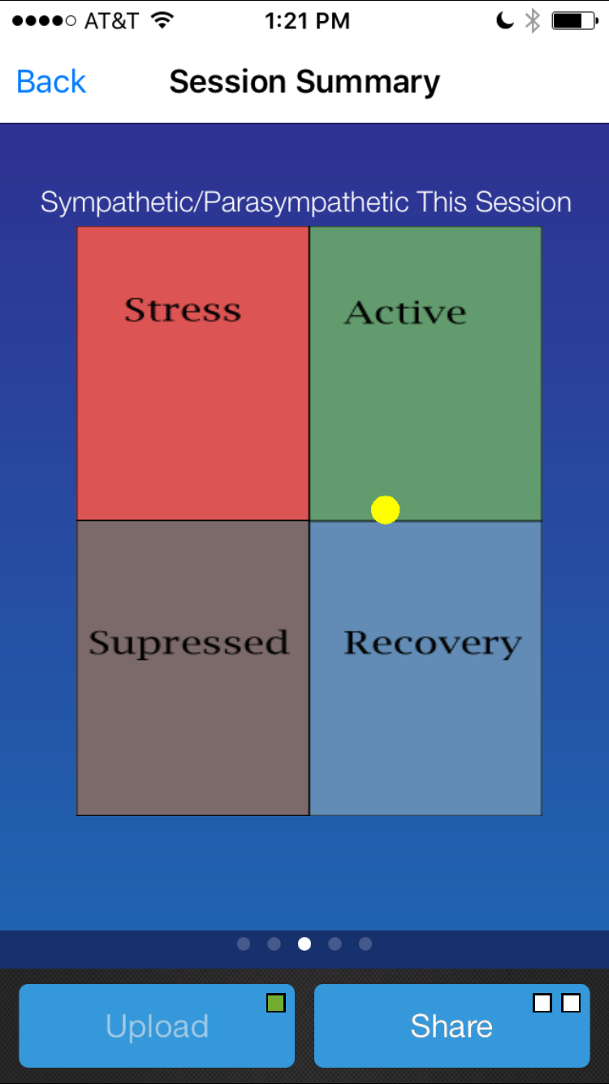
Session Summary Reports
Swipe again to see your Resilience chart. This chart shows you where you are compared to the average person. It is based on age and gender.
Stressed
Positive
Check Engine!
Tired

Slide 26
Stressed Recommendations
People who express their feelings appropriately do not carry as much stress as people who are afraid to say what they think or feel. Open up an don’t be afraid to say no.
Simplifying your life is an excellent stress reducer. Evaluate your activities and get rid of the ones that are not aligned with your life goals. Make time for yourself.
Regular exercise is an excellent way to burn off steam and build resilience so that you become more accepting of situations and thus feel less stress.
Eating healthy can do wonders for you ability to manage stress. It can improve weight and energy levels, making it easer to handle daily stressors.
Caffeine and alcohol are poisons to the nervous system and can leave you on edge so use these in moderation during stressful times.
Laughing is one of the most effective ways to reduce stress. So go out to a comedy club or watch funny movies on a regular basis

Slide 27
Check Engine
Check Engine! Mind-body exercise such as Yoga, Qi Gong, Tai-Chi and breath work has been clinically shown to relieve unhealthy stress.
Your Check Engine light is on. Did you know that medications, including over the counter products, can aggravate anxiety or depression. Please be mindful of medications.
Are you getting enough sleep? Chronic sleep deprivation not only makes you irritable and susceptible to stress, it also depletes your vitality and can lead to other serious physical and mental health issues.
Is this an emotional Check Engine? Crying can be an excellent way to give yourself a boost. Holding in emotions has a depressing and detrimental effect on your health. If you are holding in a good cry, go somewhere alone and let it all out.
Check Engine and look under the hood! People who express their feelings appropriately do not carry as much stress as people who are afraid to say what they think or feel. Open up an don’t be afraid to say no.

Slide 28
Tired
You may feel a bit tired today. Are you coming down with a cold? Take it easy today and make it a point to get some fresh air. If you are not sleeping well take a nap.
Your body is a bit low in vital energy today. Are you drinking enough water? Falling short on fluids can make us forgetful and foggy. Stay hydrated today and avoid caffeine after noon.
You are a bit depleted today so be sure to have a protein rich breakfast and eat organic healthy meals every 3-4 hours. Avoid simple carbs from boxed or processed food. These foods create cravings and encourage fatigue.
Your Resilience is low today. If you were thinking about putting on sweats today think again! Research shows that what your wear reinforces your internal state. So put on a power outfit and give yourself a mental boost!
Energize your spirit today by listening to your favorite happy songs! Music can effectively distract you from feeling fatigue and singing can actually boost your mood and physical health. So go crank some tunes!

Slide 29
Positive
You are physically up today! Be sure to get regular exercise to release endorphins to keep you in a good mood. This could mean outdoor or gym activities to taking stairs instead of the elevator, walk instead of driving!
You love being Resilient! Take advantage of this and spend time with your friends today. Sharing your good feelings is one of the best ways to keep them going. What you give to others you give to yourself!
You are ready to rock and roll today. Be sure to watch your thoughts and dismiss any negative ones. Embracing thoughts that promote enthusiasm and joy will keep you positive. Do a 10 minute mediation and simply watch your thoughts.
Your Resilience is great today so make some time for your passion! By carving out some time to do what you really love will help you stay in a good mood.
Energize your spirit with volunteer work. You’ll feel good about helping other people whether it is organized volunteer work or daily random acts of kindness. Spread some love today!

Slide 30
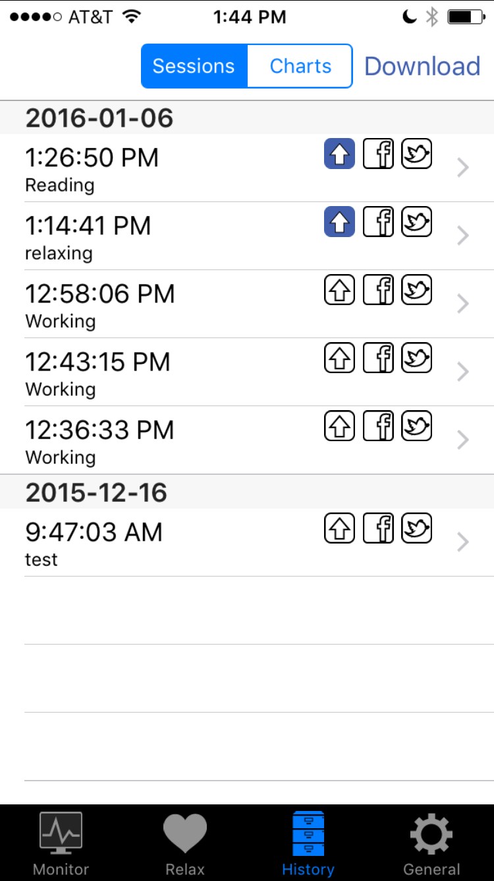
History
Select the Back button to return to the main screen, then select The “History” tab at the bottom.
At the top are 2 buttons, the Sessions button which displays the individual sessions and the “Charts” button which shows the data from ALL of your sessions. We already described the “Session” reports so lets look at the “Charts” reports.

Slide 31
History - Charts
The first screen is your “Willpower” screen and shows how your health from this session compares to your previous sessions. If you are above your reference line you ready to take on the world! If you are below your reference line then you are having a low energy day.
You need a 4 sessions for this to make sense so keep doing your readings!
Swipe right to left to see your session summary reports!

Slide 32
History - Charts
Swipe again to see your Balance of Power chart. This chart shows your “power” and your “balance” of that power.
Your power is an indication of your overall energy and ability to adapt to daily events and recover from adversity. You could say it measures the volume of your life force.
Your balance tells you if you are on the relaxed or stressed side of life.

Slide 33
History - Charts
Swipe again to see your Resilience chart. This chart shows you where you are compared to the average person. It is based on age and gender.
Stressed
Positive
Check Engine!
Relaxed

