Slide 1

SweetWater Health
Android User Guide
SweetWater Health
TM
BeatHealthy
TM
February, 2016
Copyright 2016 SweetWater Health LLC

Slide 2
Starting Up With SweetBeat on Android
Welcome to SweetBeat on Android!
Requirements:
Android device 4.3 or newer (tablet or phone)
IMPORTANT: Additional hardware is required
  Bluetooth Low-Energy chest strap heart rate monitor
  Strap must support RR-Intervals
  Here is a list of our supported heart rate monitors: http://www.sweetwaterhrv.com/healthsensors.shtml
Copyright 2016 SweetWater Health LLC

Slide 3
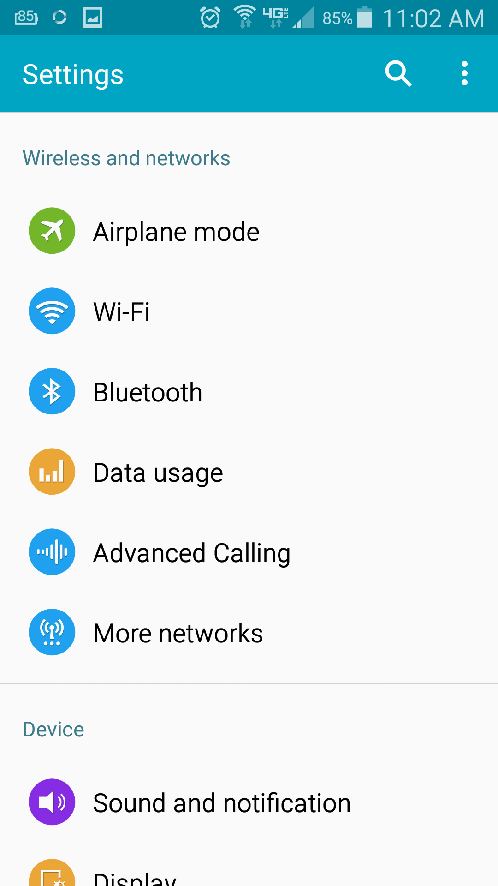
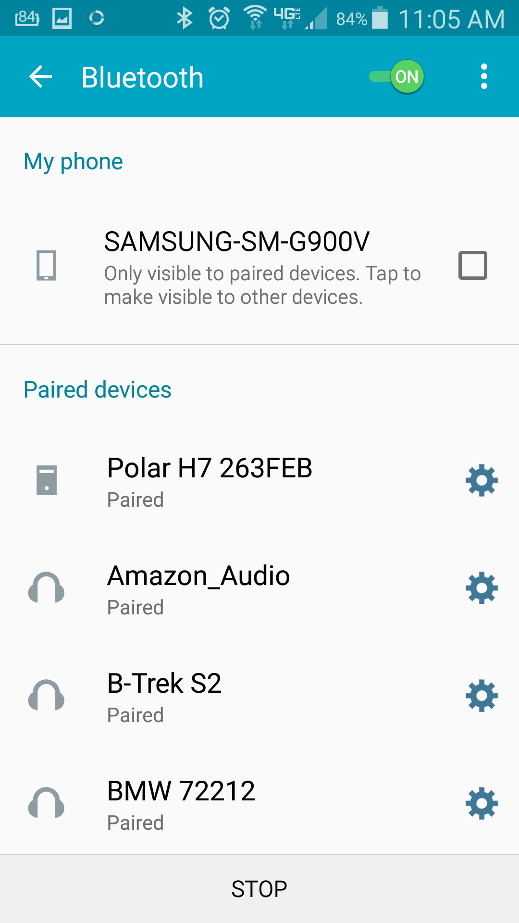
Getting Started
You have purchased SweetBeat on Android either through the Google Play store, our website or one of our partners’ websites
You will need to pair your heart rate monitor in your device’s settings
  Put on heart rate monitor ensuring “leads” are wet before pairing. You can use either gel or water/saliva.
  Open device’s Settings, find Bluetooth, select monitor. You might have to scan to find it.
Find Bluetooth Heart Rate Monitor
Copyright 2016 SweetWater Health LLC

Slide 4
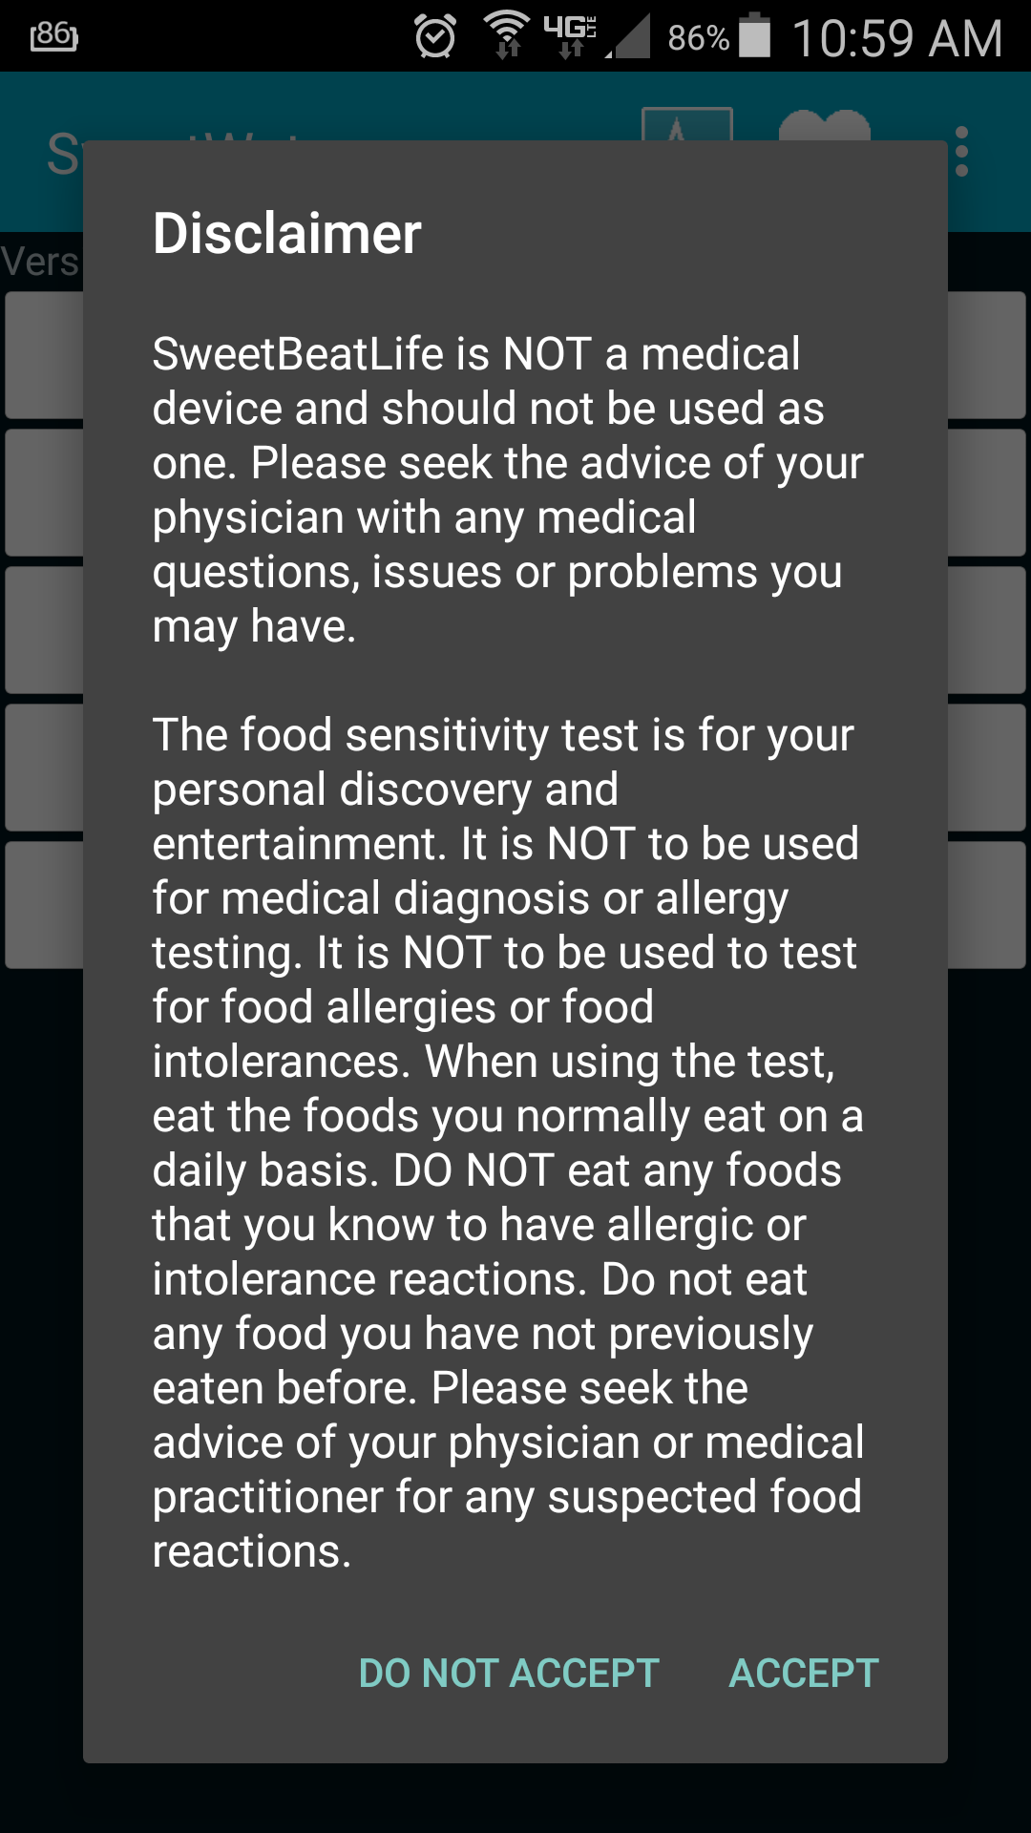
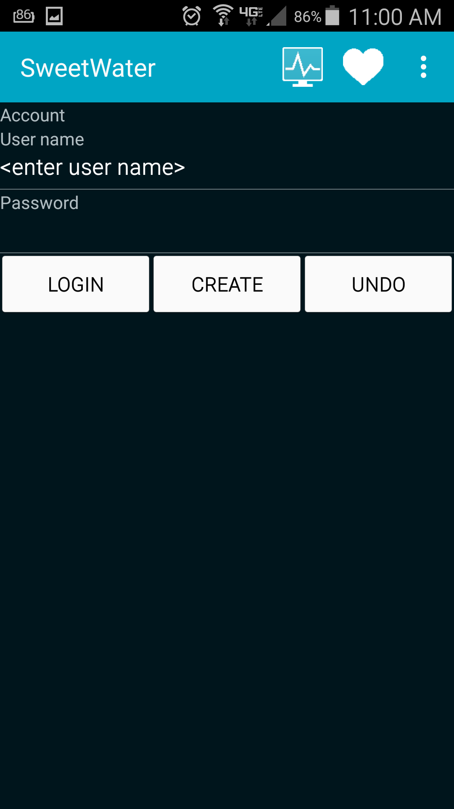
Getting Started
Open the SweetBeat App
  You might have to finish installing if you downloaded it from a website
  Read over the disclaimer and select “Accept” to continue
The next screen will ask you to create an account or login:
  Enter user name
  Enter password
  Select either Login or Create
  It will say logged in above “User Name” once you are done.
Copyright 2016 SweetWater Health LLC

Slide 5
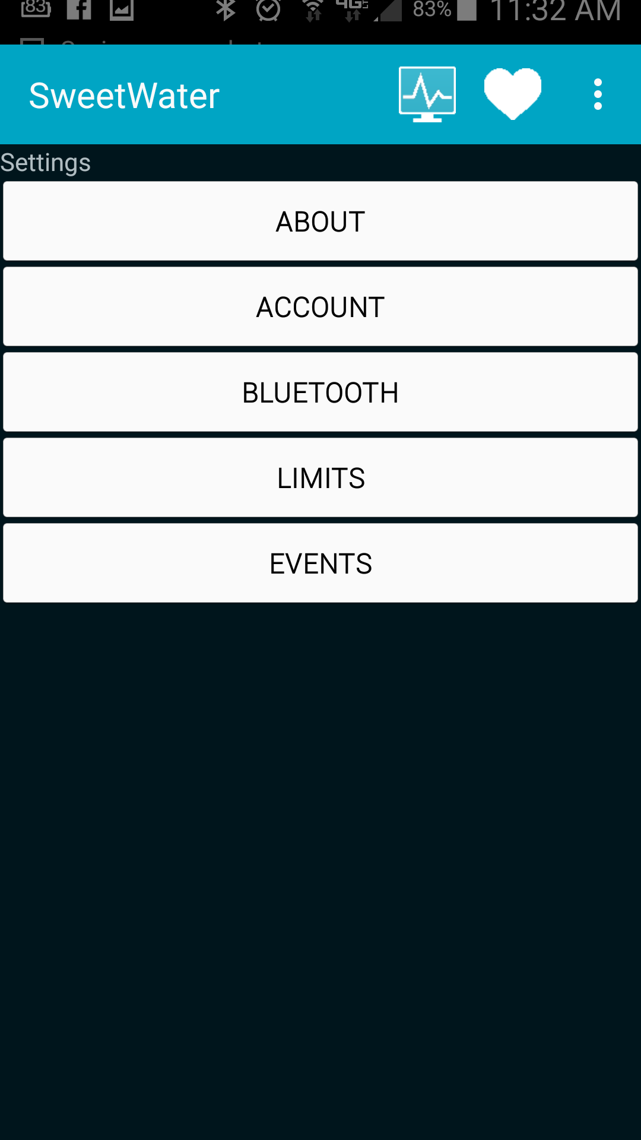
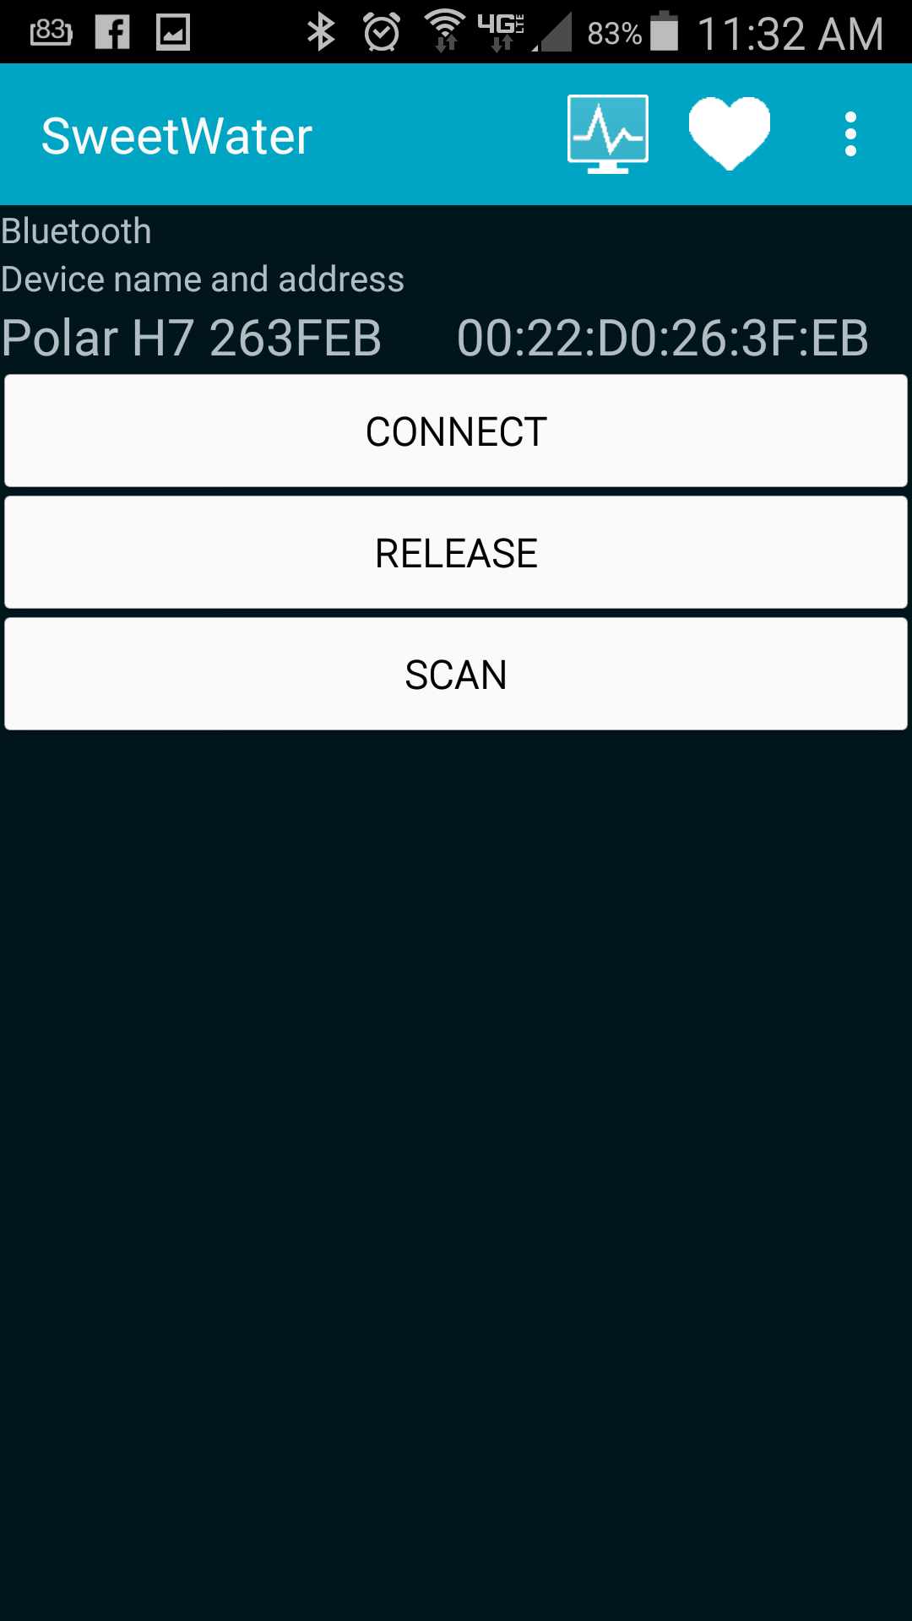
Pair Heart Rate Monitor in App
Next you will want to pair your Bluetooth Heart Rate Monitor to your application.
  Select the dots in the top right corner, then select “Settings”
  Select “Bluetooth”
  Select your device
    If you do not see your device, you will want to “Scan”
    If you want to disconnect, select “Release”
    You will see a message above the buttons that explains what is going on
Drop-down menu
Device status will be listed here
Bluetooth
Settings Screen Bluetooth Screen
Copyright 2016 SweetWater Health LLC

Slide 6
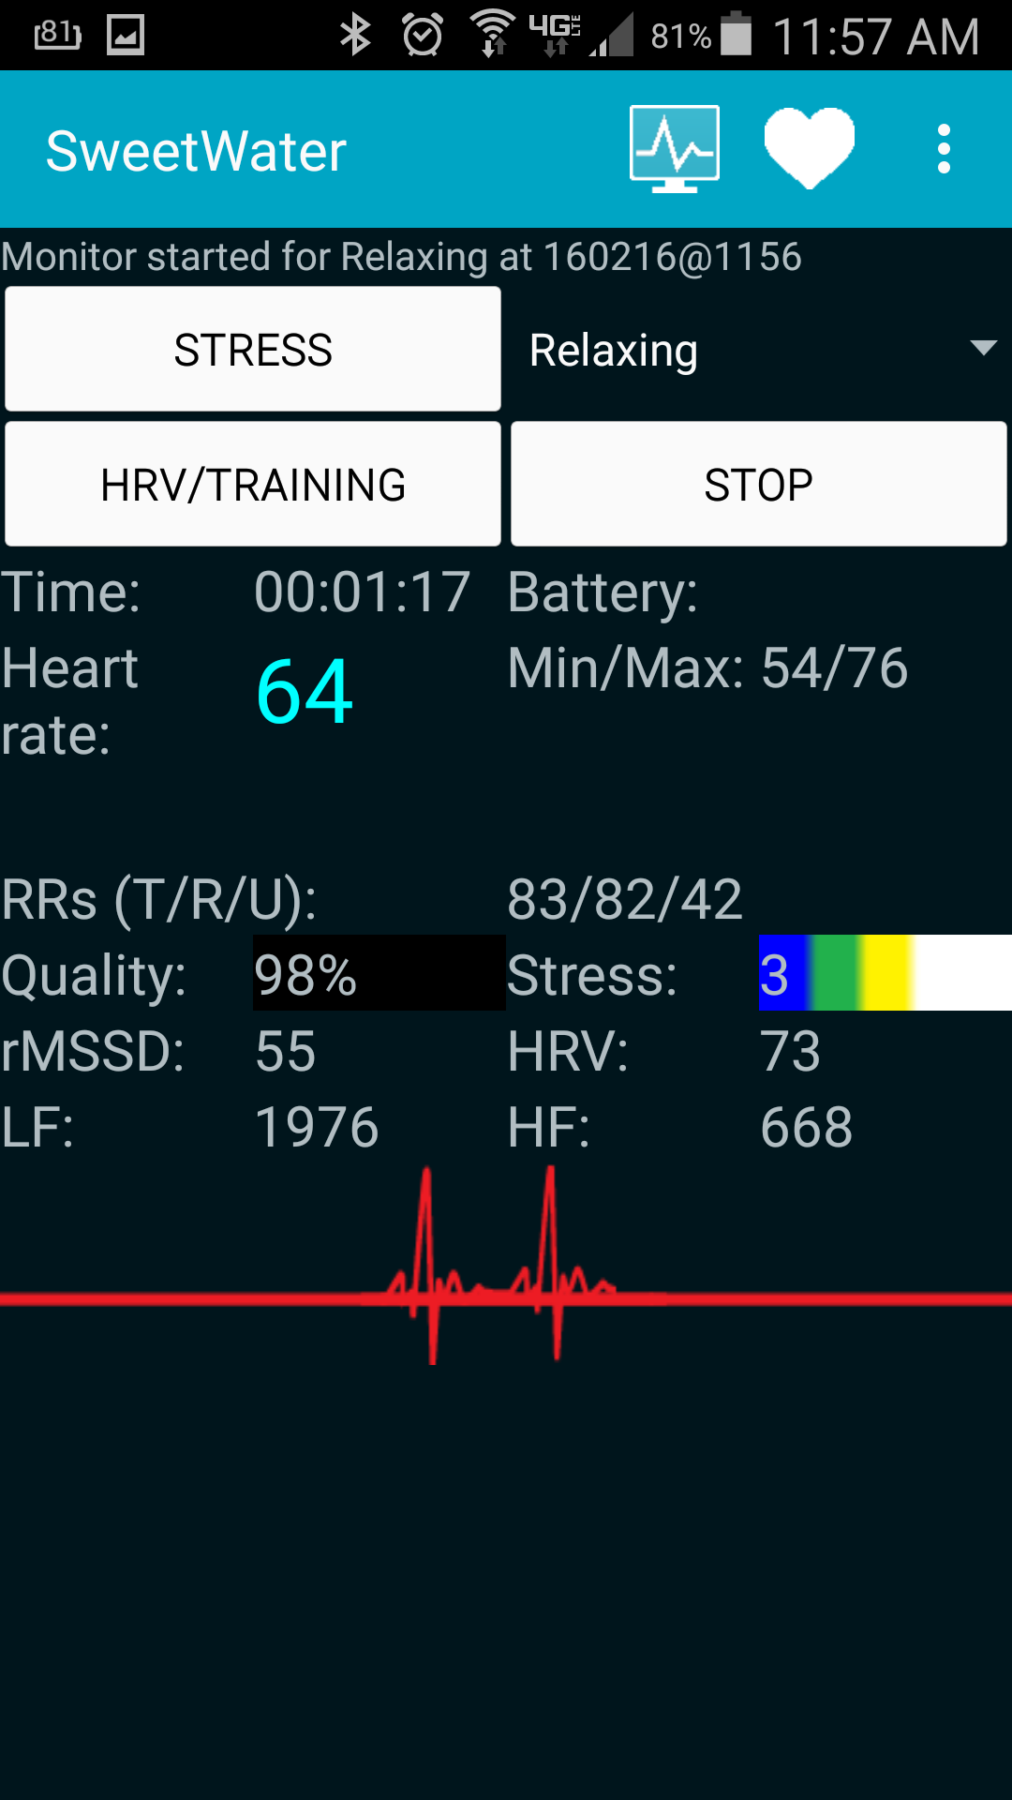
Run a Session
Select the Monitor Screen tab
  If the heart rate monitor is not paired correctly, it will ask you to connect again. If it is, you will see your heart rate populating.
Select “Stress” to run a regular session
  Select tag before starting session
  Press Stop when complete
  Your session is automatically uploaded and tagged with selected tag
Run a “HRV for Training” session
  Performed in the morning before you get out of bed
  Automatically stops after ~ 3 minutes
  These sessions will show up in your HRV for Training graph and will automatically have HRV tag
Session tag
Monitor Screen
Copyright 2016 SweetWater Health LLC

Slide 7
Real Time Session Information
During the session, real time information is displayed
Please review HRV Measurement Explanations to understand these parameters.
Stress session
  Time counts up and displays session length
  Stress will go from 1 to 5. 1 being the least stressed and 5 being the most stressed
HRV for Training session
  Time will count down to 0
Session Quality will go from black to red if the quality is not good
Monitor Screen
Session description
Stress score
Real-time EKG
Copyright 2016 SweetWater Health LLC

Slide 8
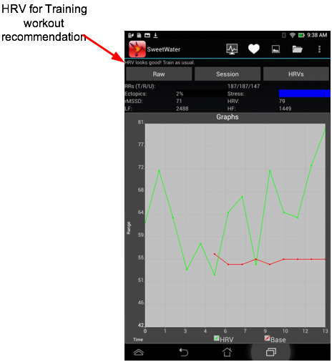
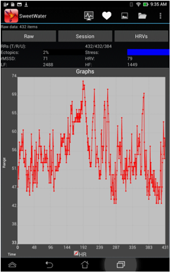
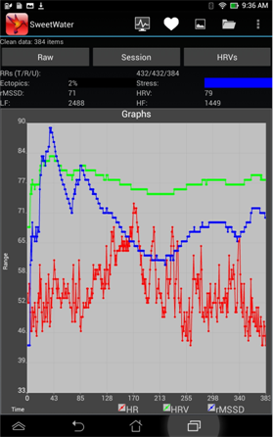
Charts and Graphs
Select the 3 dots on the right side, then select “Analyze”
  The menu options will be different depending on your screen size. You may see the dots only or you may see the picture image shown to the right.
  Raw RRs is the default session view
  Select Session button to view session details
The graphs screen will automatically open at the end of an HRV for Training session
  Select HRVs button to view HRV for Training chart
Graphs
HRVs
Session
Graph
Raw
Copyright 2016 SweetWater Health LLC

Slide 9
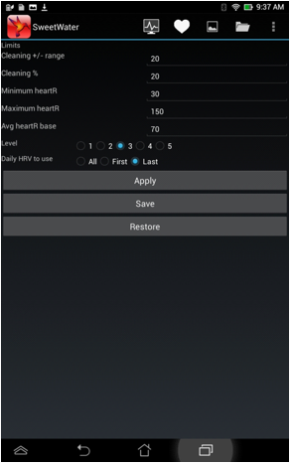
Limits screen
From the Settings screen one of your options is the Limits screen
We recommend not changing any of these values EXCEPT the “Level” value
What is “Level”
  Because many people are chronically stressed, their stress level is always “in the Red”
  If you are always pegged at red, the value is not useful and you will likely not use it
  The Level is a personally adaptive scale to help people with chronic stress actually see their stress change and be in the “Yellow”, “Orange” or “Red” (maybe even “Green”)
  Think of it as a challenge level where Level 1 is beginner and Level 5 is advanced
  We recommend changing to level 5 and backing off as needed if you are always “in the Red”
Limits Screen
Copyright 2016 SweetWater Health LLC

Slide 10
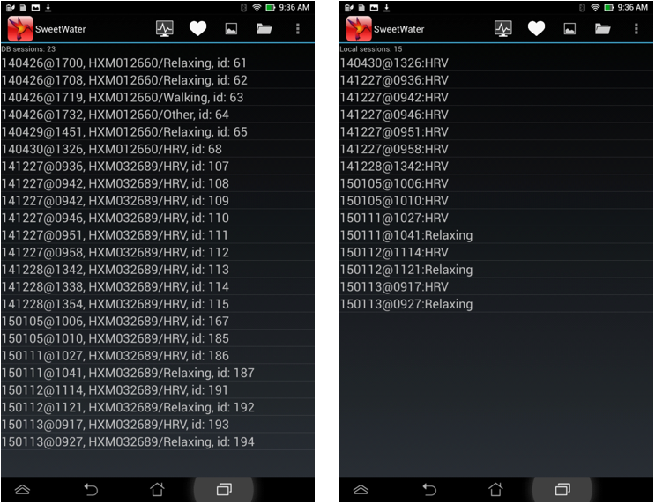
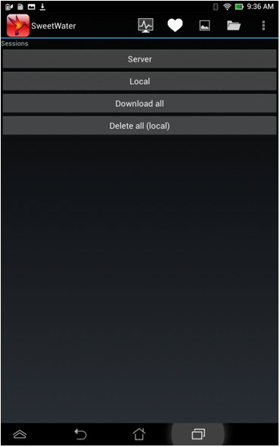
Viewing Saved Sessions
Select the History tab
  Server button
    Displays all sessions on server
  Local button
    Displays all sessions saved on your device
  Download All
    Allows you to download all sever sessions to your device
  Delete All
    Deletes all LOCAL sessions
Server Local
History
Screen
Copyright 2016 SweetWater Health LLC

